Slide 1

POVs &
Experience Prototypes

Slide 2
Hello!
We are HELM

Slide 3
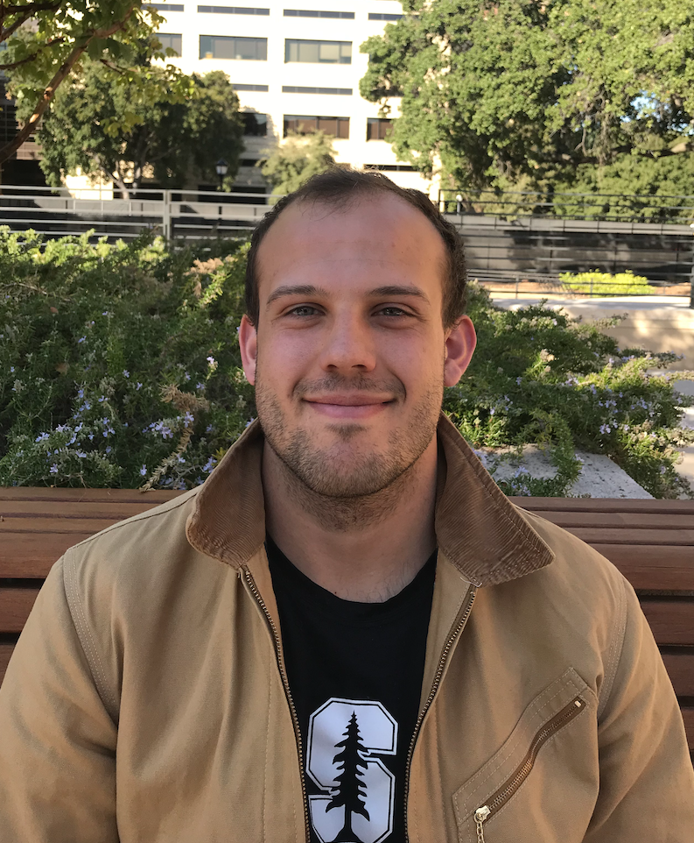
Hannes Boehning
Interested in creating a more holistic and humanistic education tech experience

Slide 4
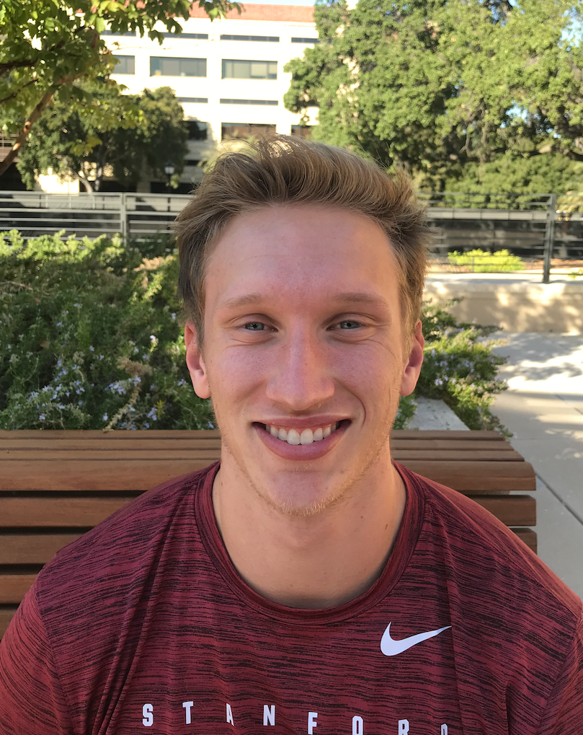
Eli Wopat
Both parents are math teachers, interested in specialized education

Slide 5
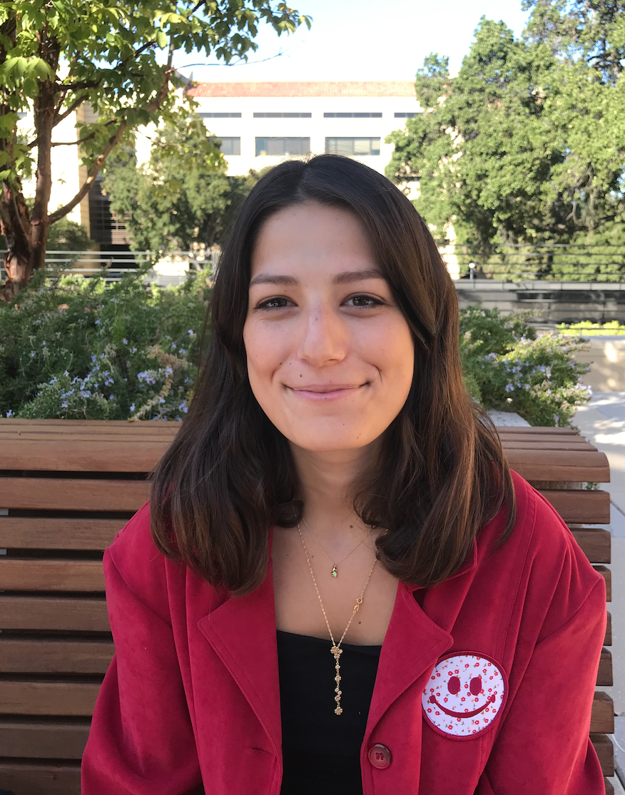
Lee Alpert
Interested in making education more accessible

Slide 6
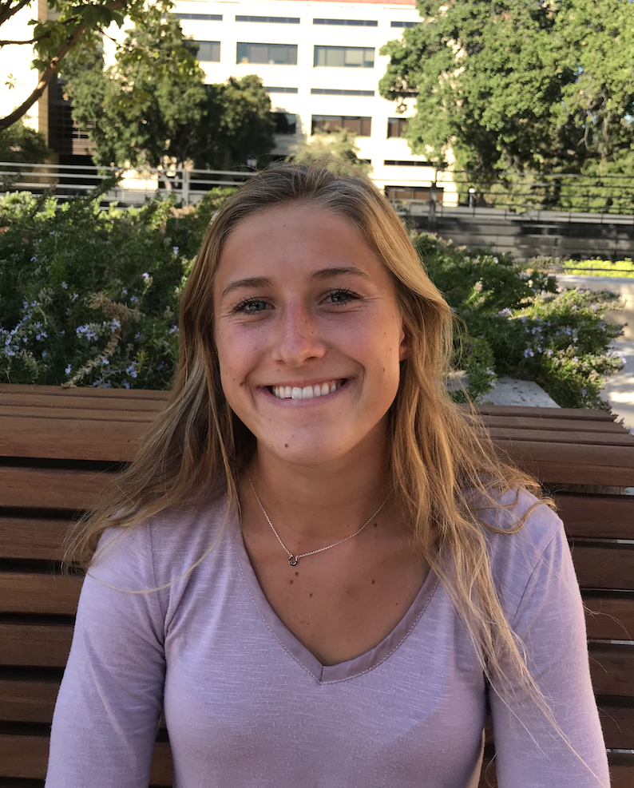
Mia Paulsen
Interested in creating tech for learners everywhere, regardless of age or status

Slide 7
Problem Domain
Bridging the divide between different aspects of education

Slide 8
Initial POV
1
Let’s start with the POV we had going into this round of testing

Slide 9
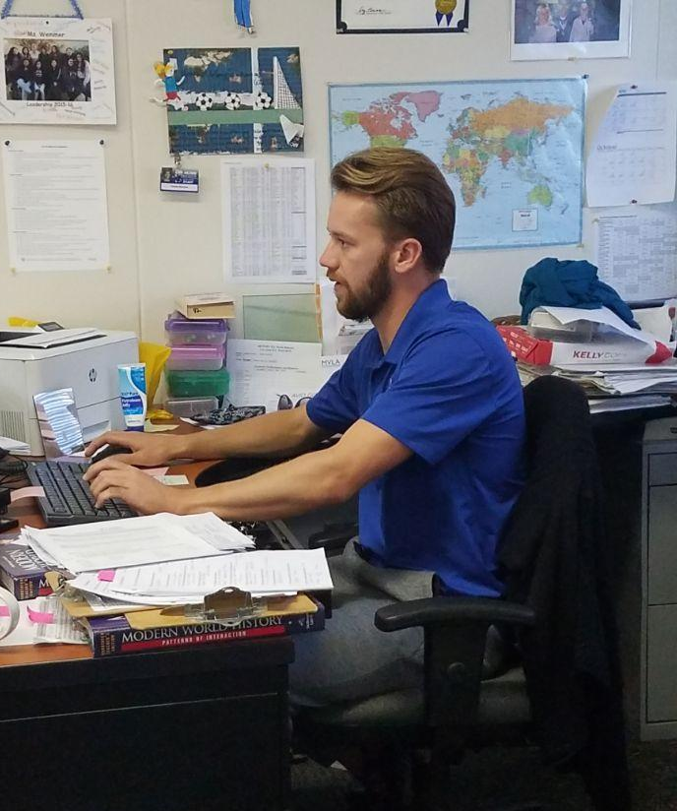
There should be less technology in the classroom
“

Slide 10
We met Keegan, a substitute teacher in the Sequoia Union School District
We were amazed to realize that he thinks technology still isn’t made for the classroom and that there is a contrast between intention and effect
It would be game changing to build specialized technology based on classroom conditions

Slide 11
Additional Needfinding
2
This week we set out to hear from more people about their educational experiences

Slide 12
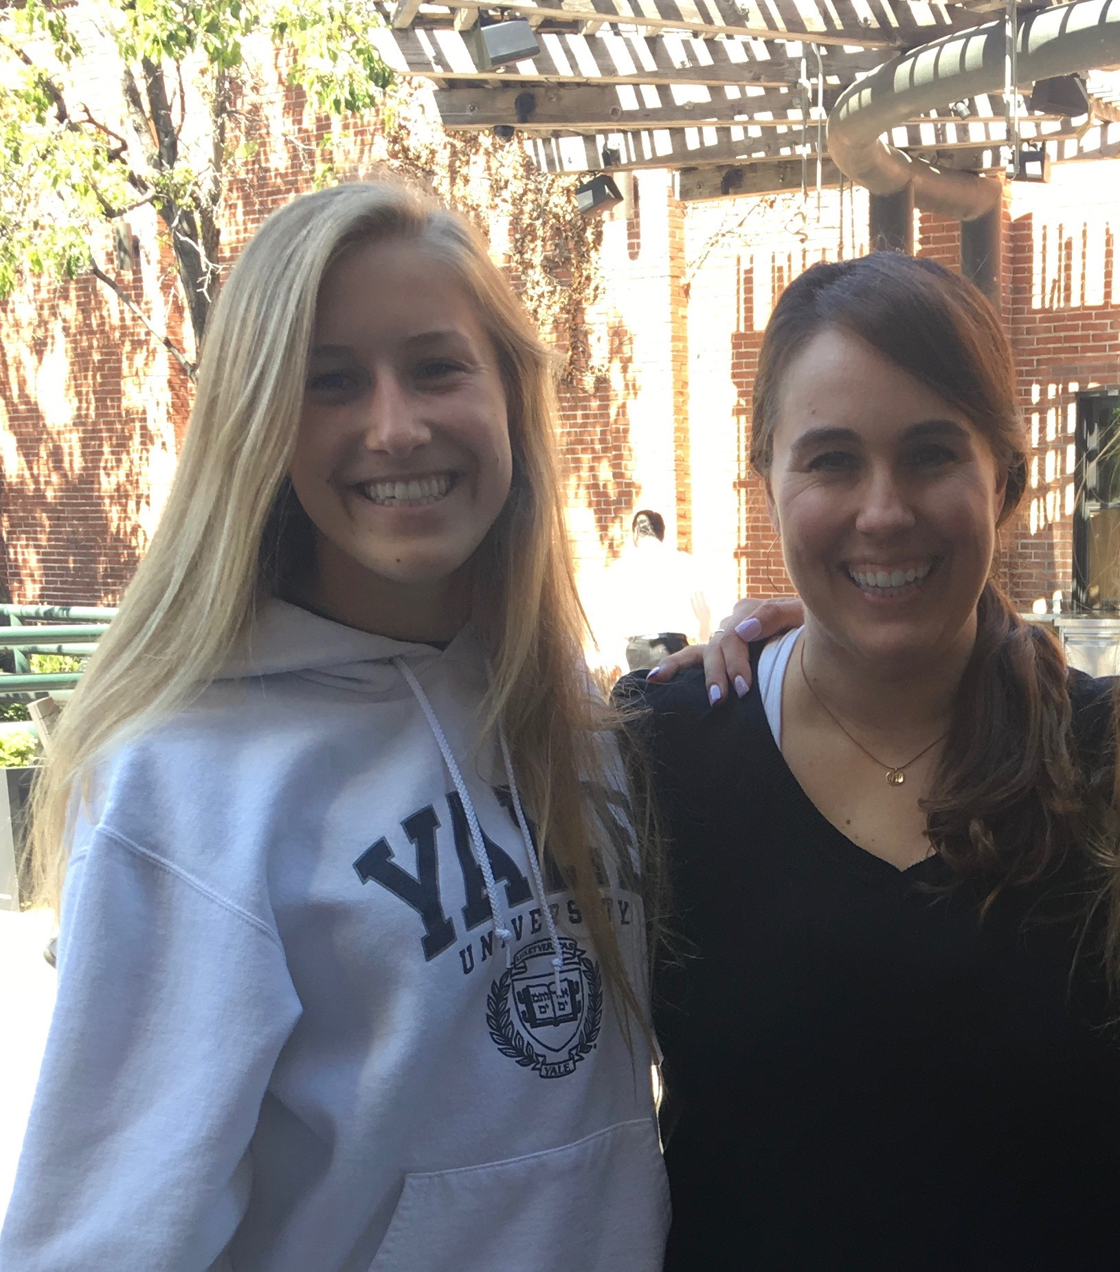
Mrs. Otsuka, an AP Lit teacher
Creative lesson plans reinforce human connection and inspiration
Her best lesson plans are unique and interactive
Notes:
Interviewed at Cafe Borrone’s

Slide 13
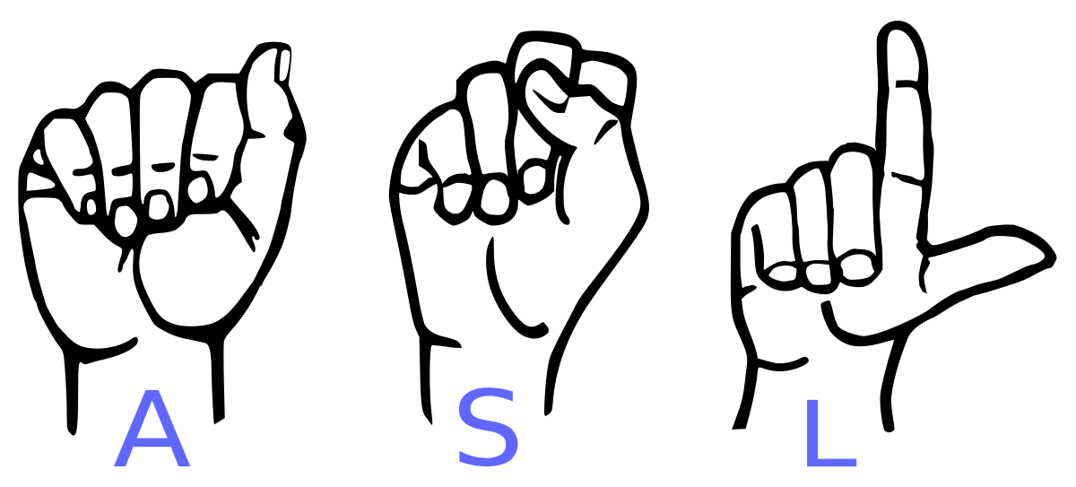
Cathy Haas, a deaf ASL professor
Games can provide a personalized learning experience
Technology has amazing potential
Notes:
Taught Koko the gorilla sign language!
Interviewed on campus

Slide 14
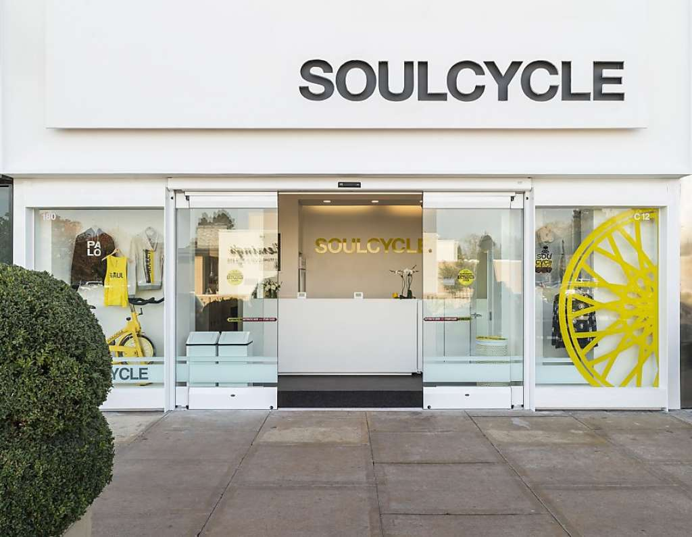

Brenda, a business student
Professors lack knowledge of technology
Technology can be helpful if used correctly
Notes:
Interviewed at the Soul Cycle in the Stanford Mall

Slide 15
Revised POVs
3
Next, we dove into our needfinding results to develop 3 key POVs

Slide 16
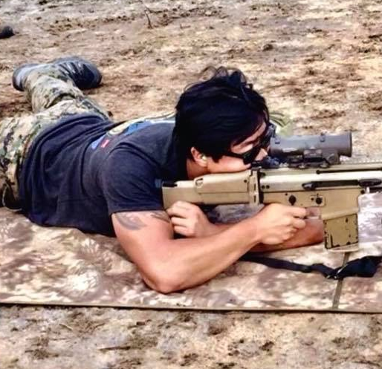
I typically listen to news in Arabic to keep up with my language skills
“

Slide 17
We met Joel, a former marine intelligence officer and current Stanford student
We were amazed to realize that he associates positively with the language despite learning it in extremely tiring and rigorous conditions
It would be game changing to redesign the language learning process to make it more positive and dynamic

Slide 18
How might we...
Integrate the learning of languages with other subjects?

Slide 19
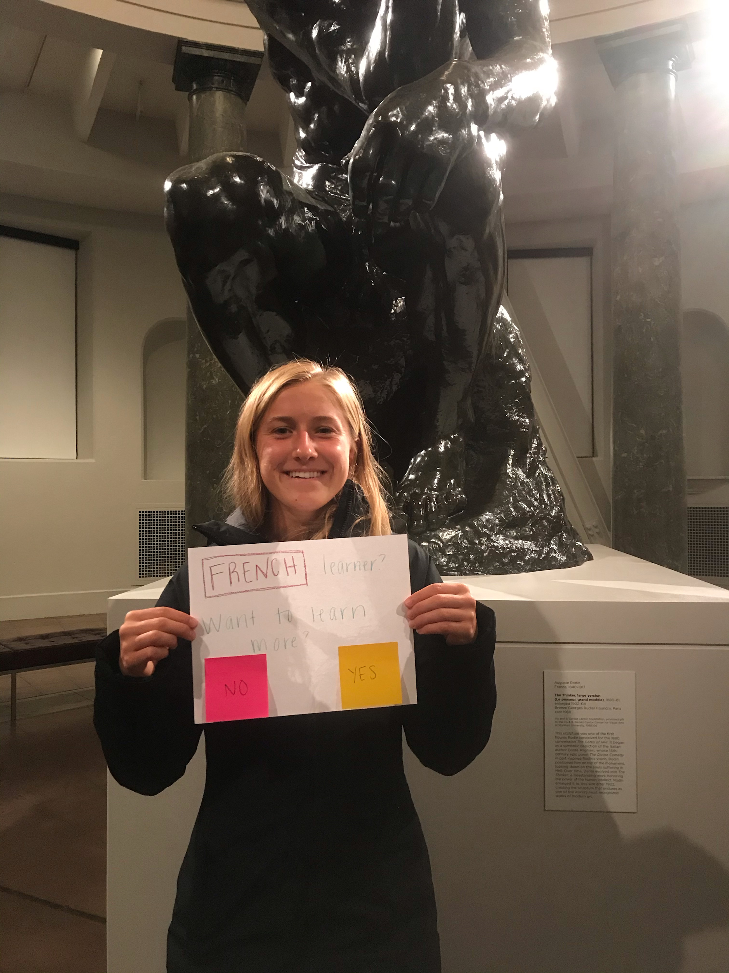
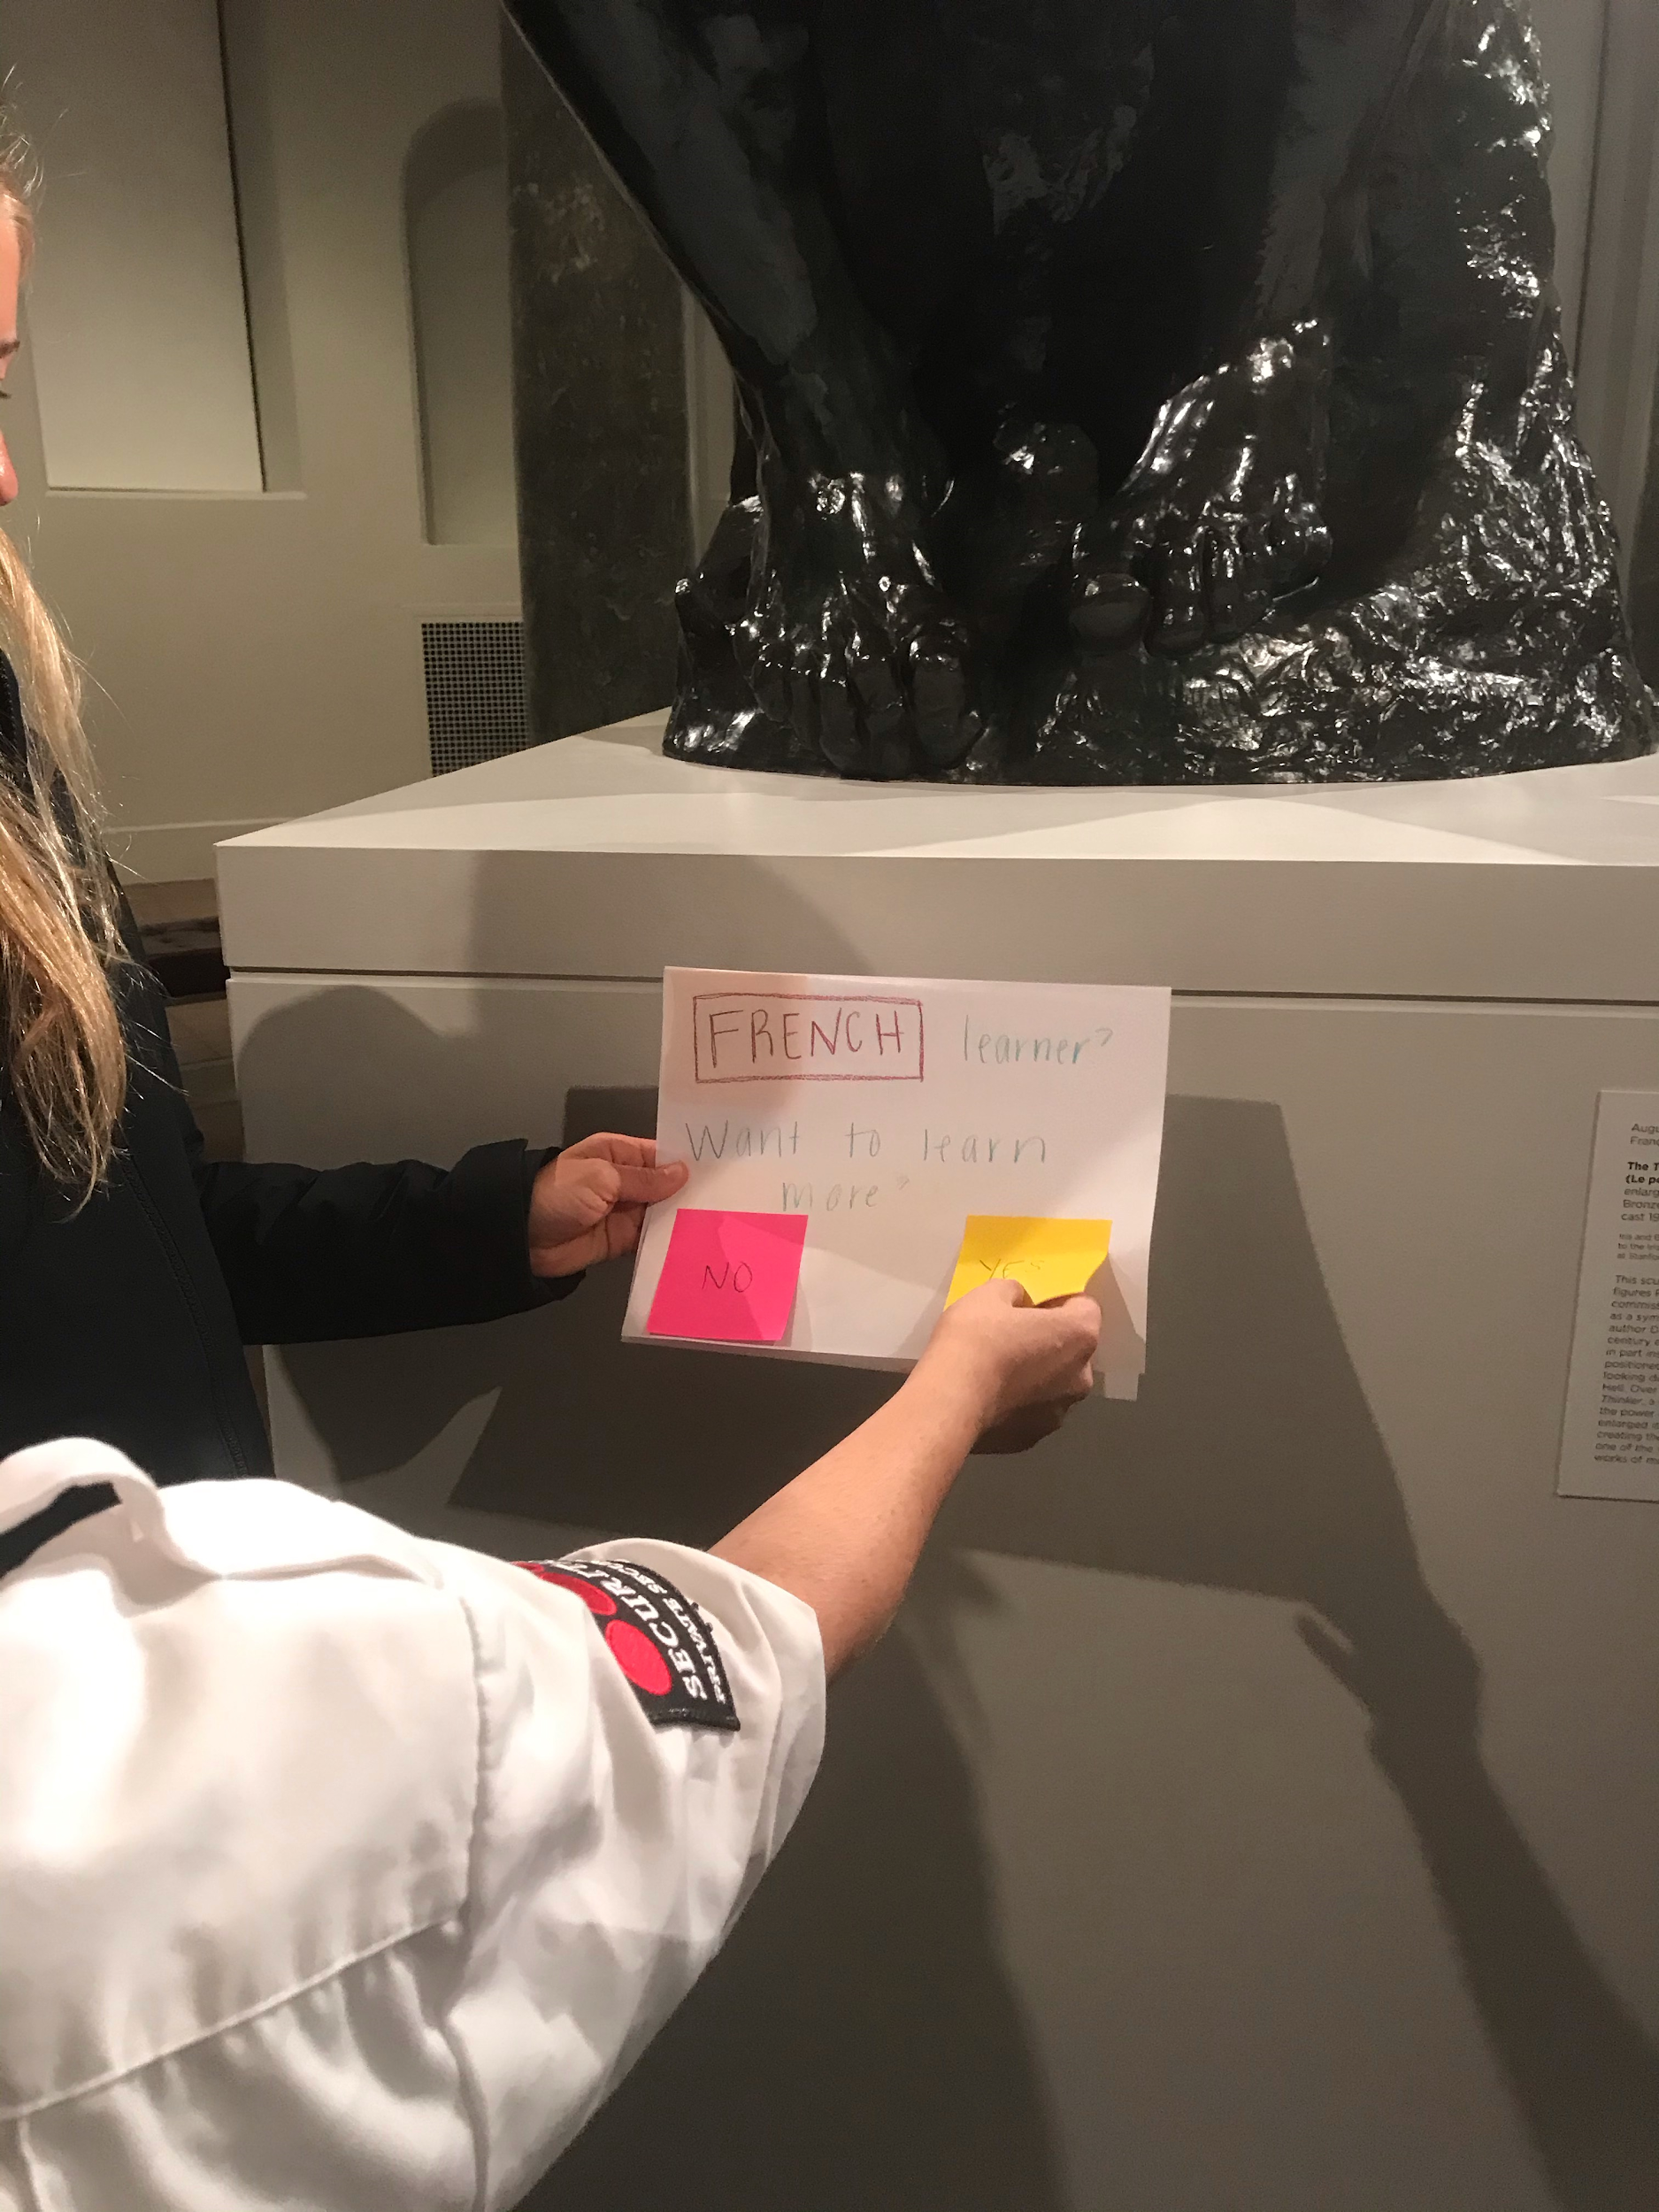
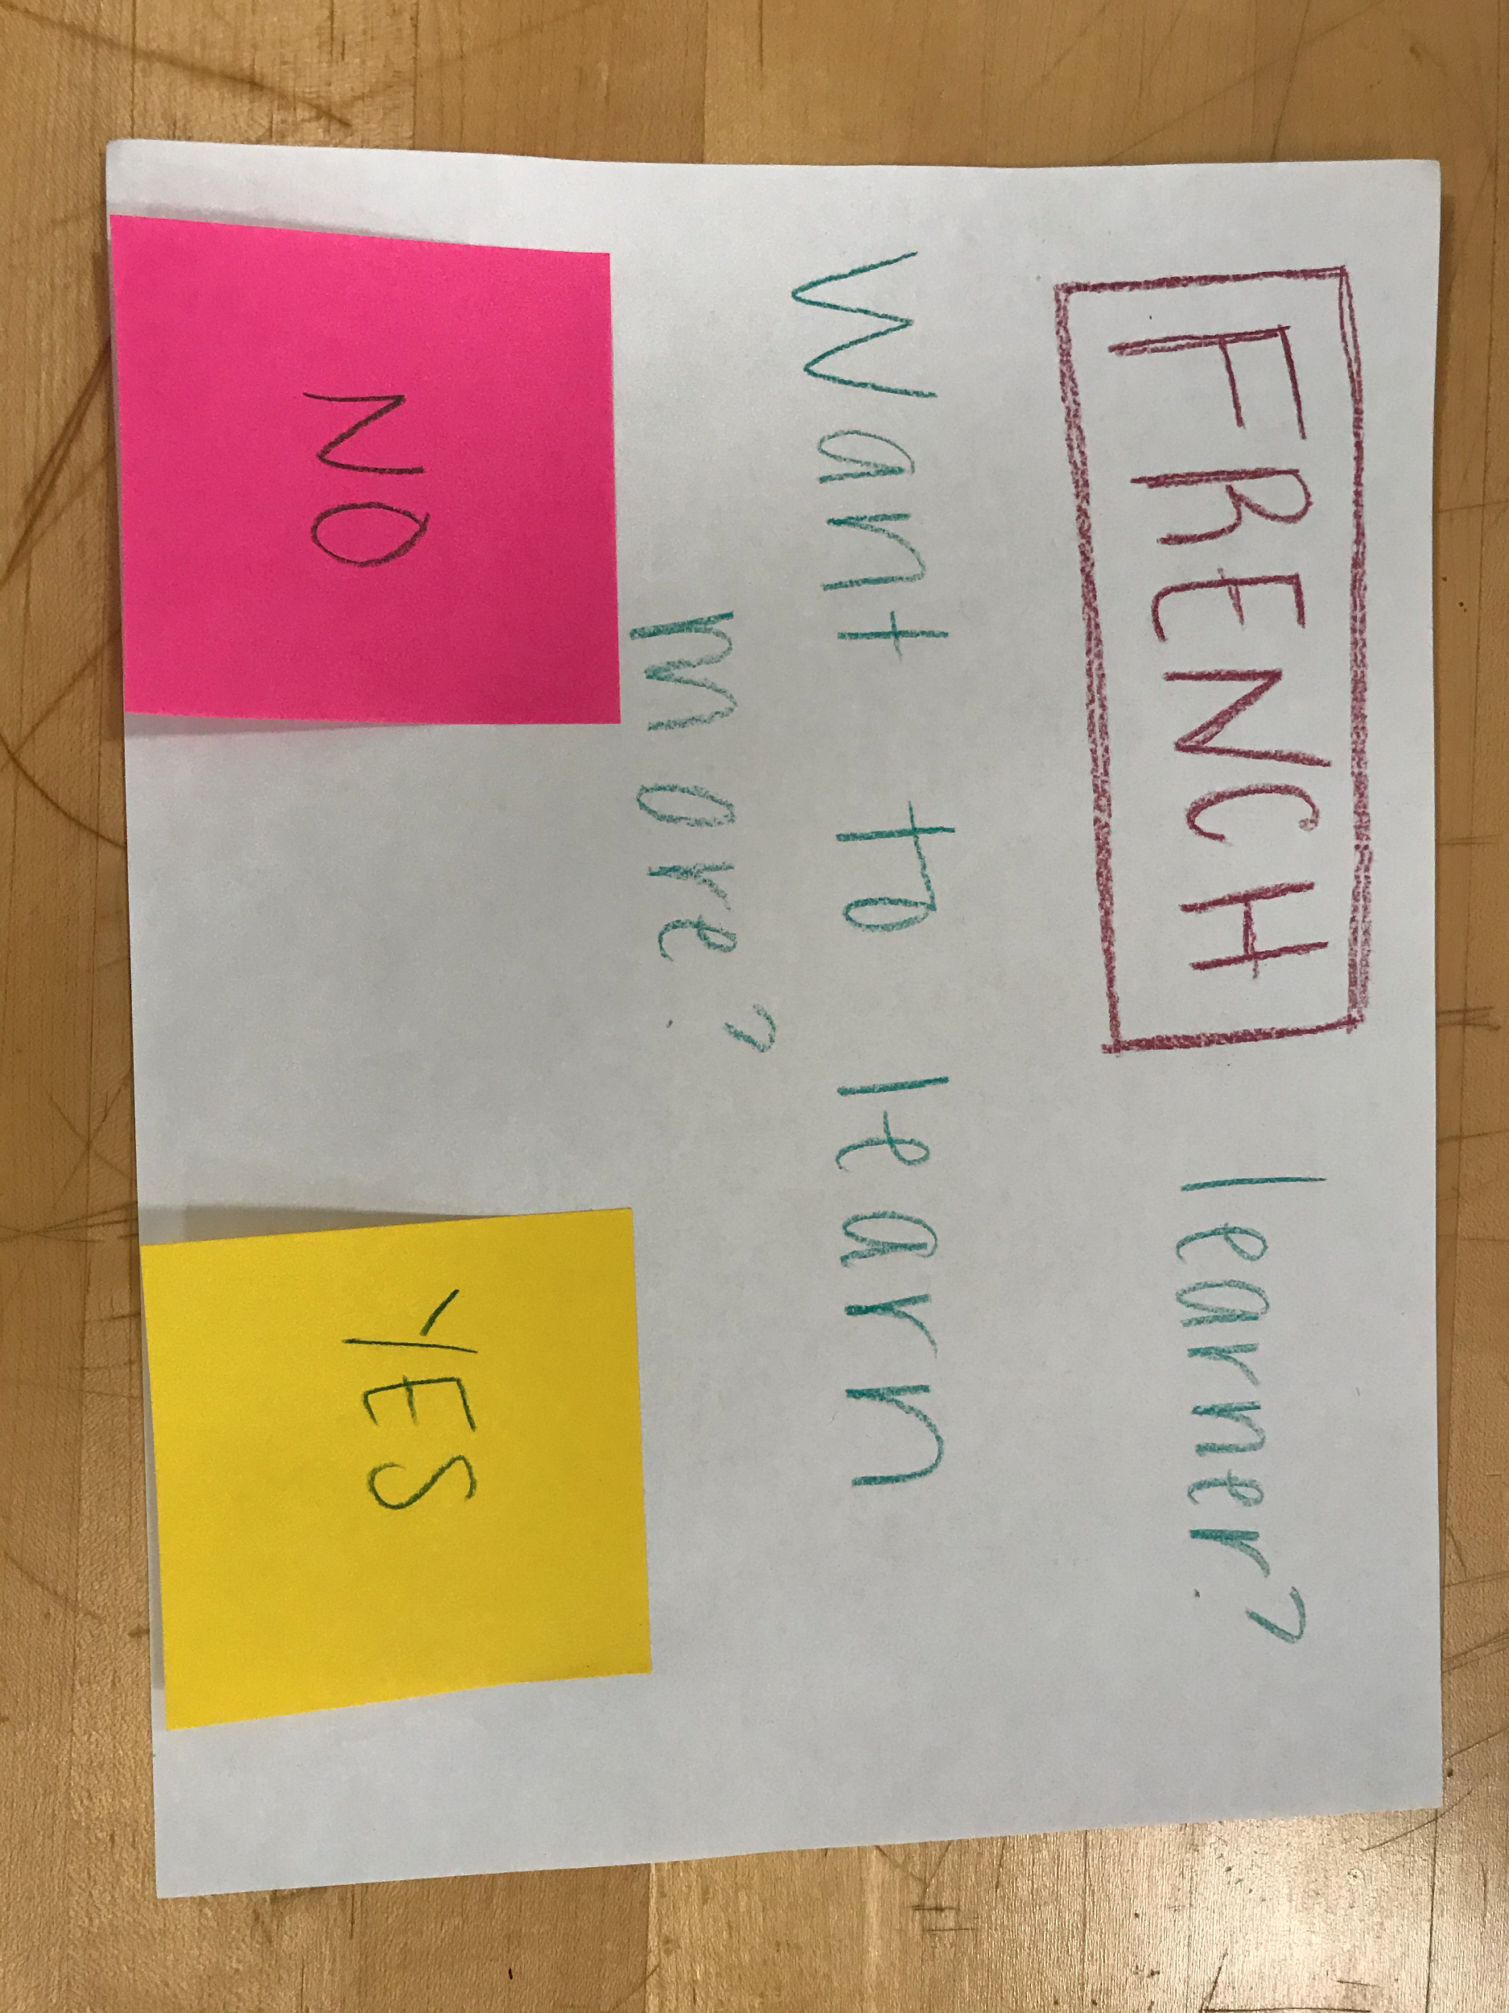
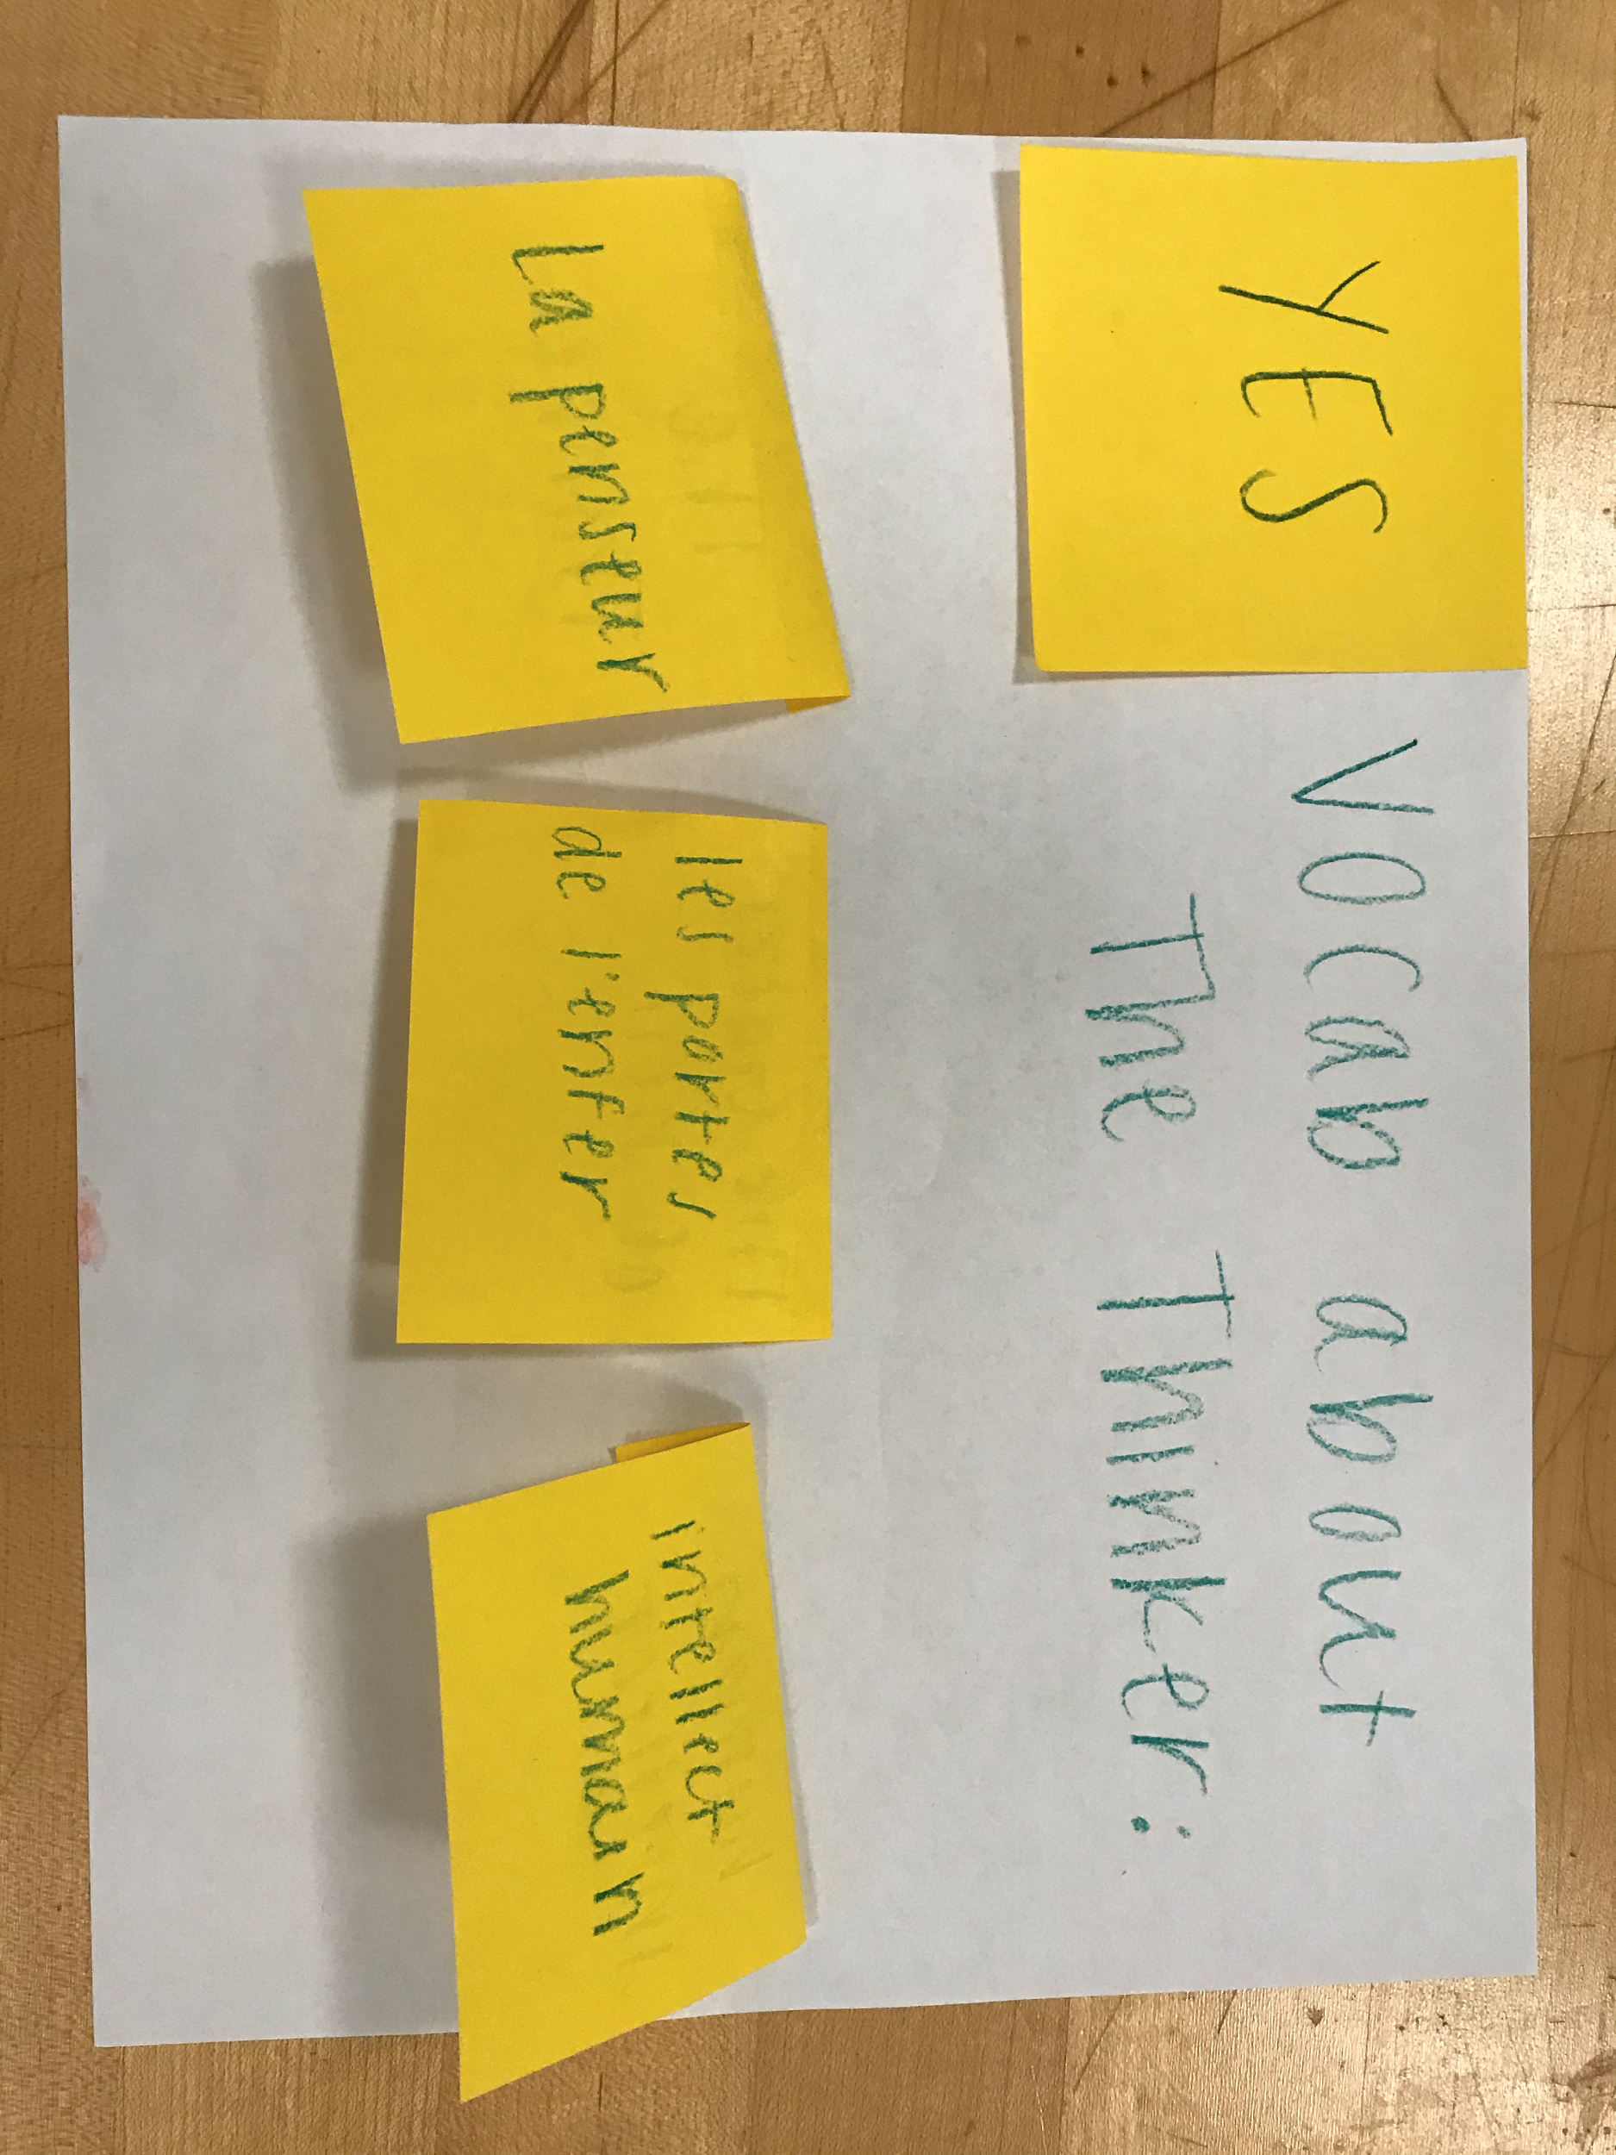
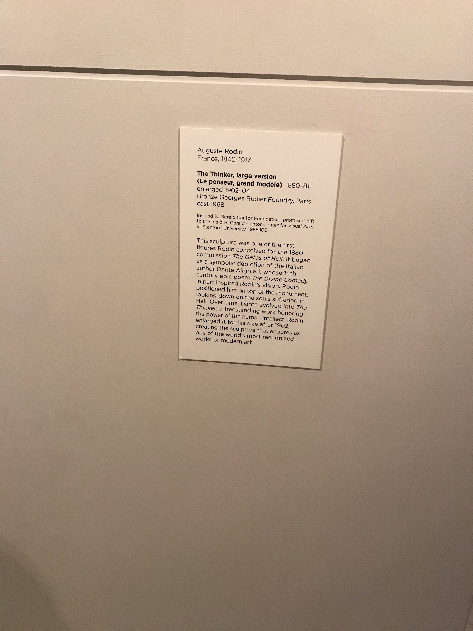
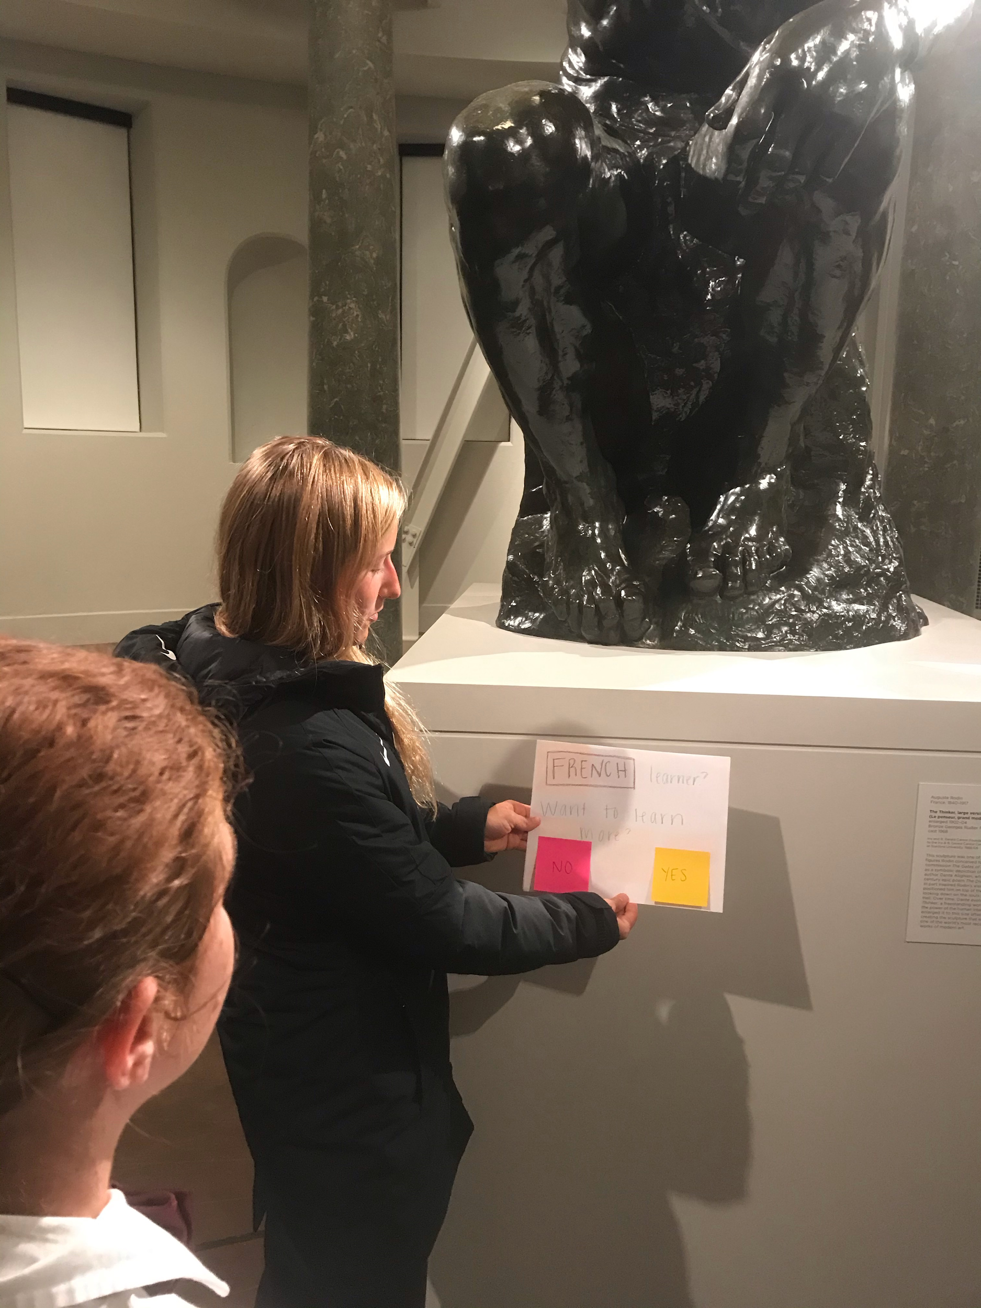
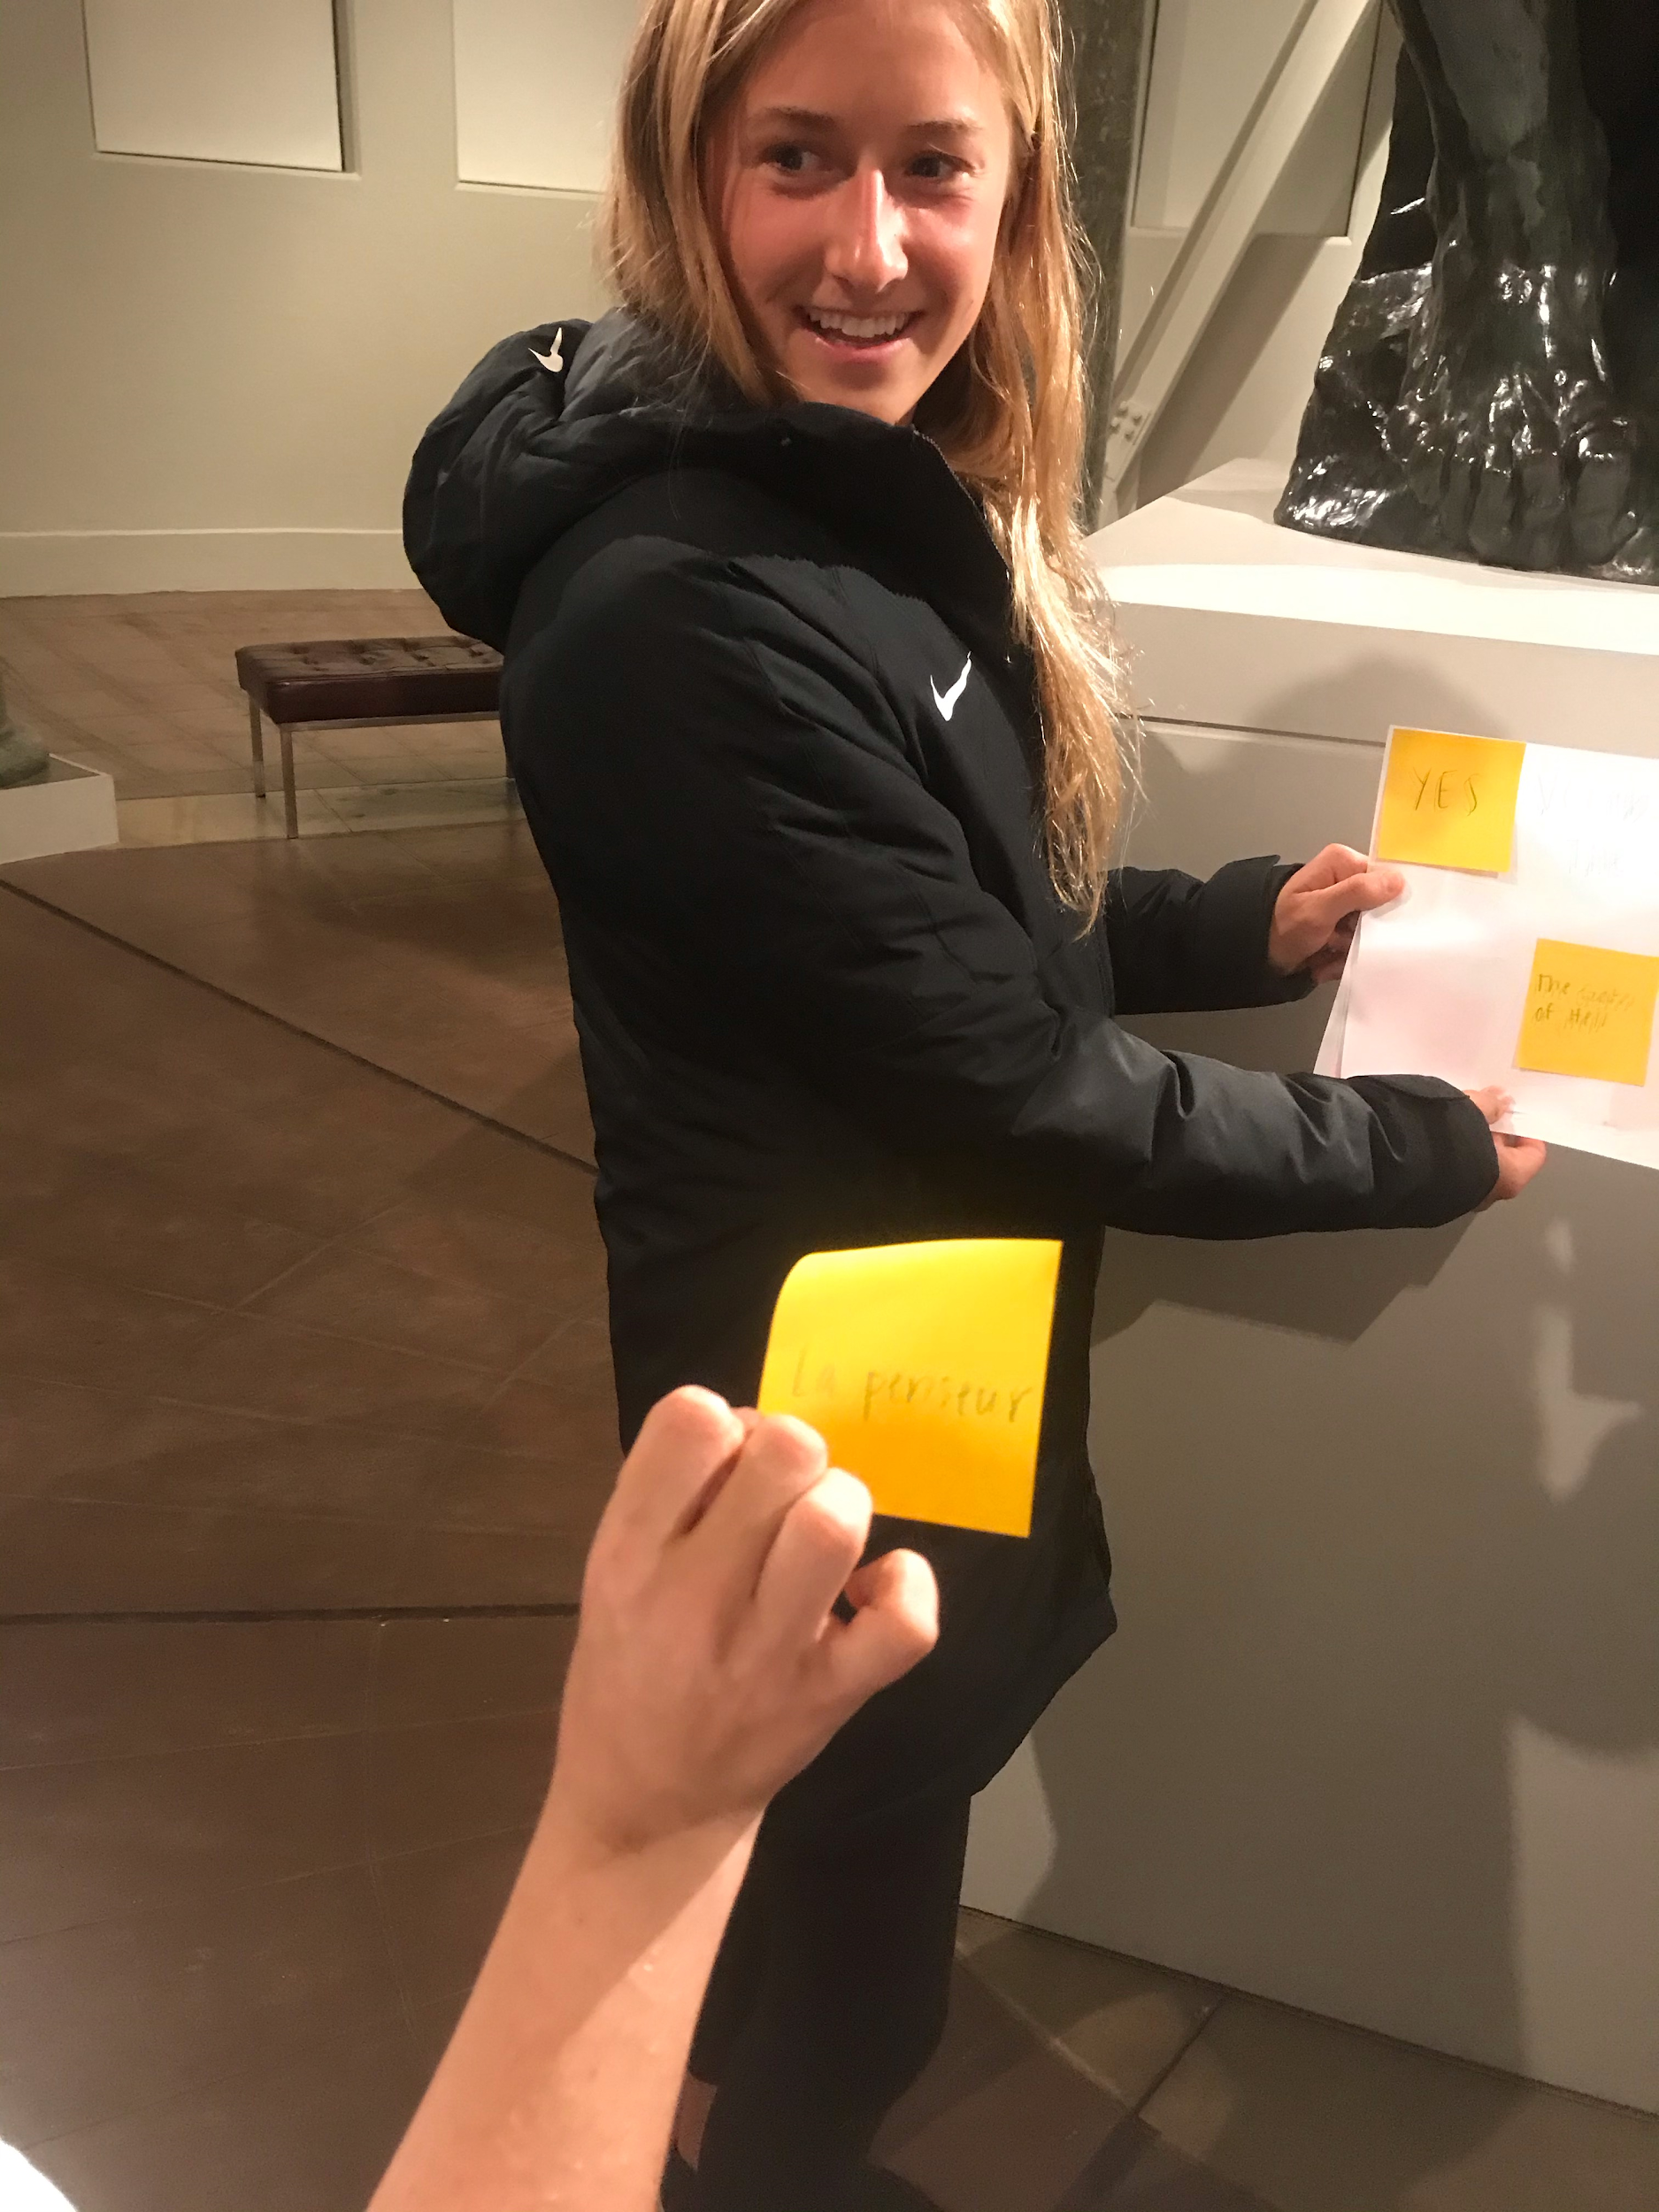
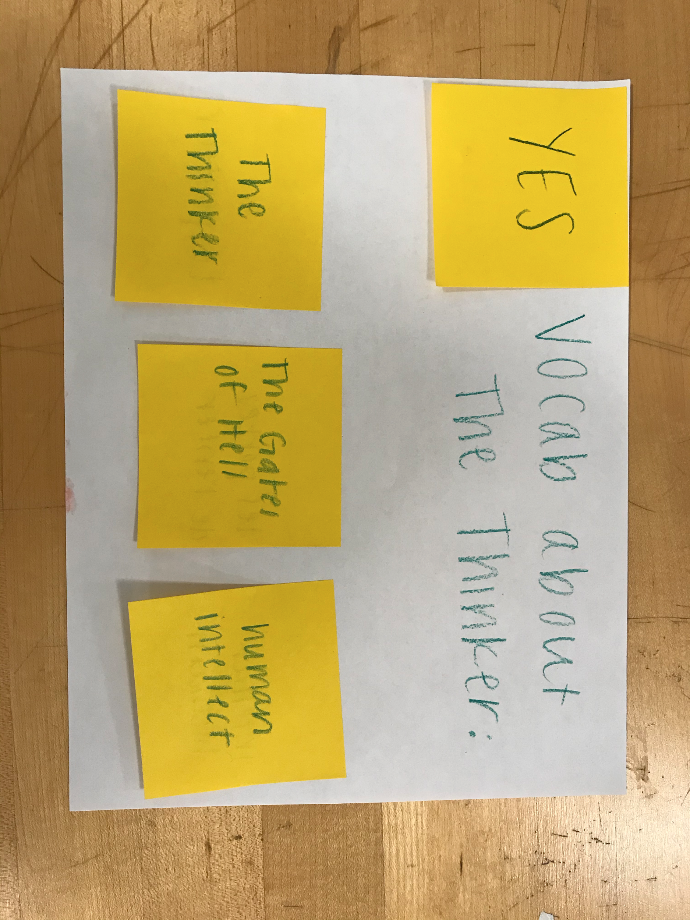
Experience Prototype #1 - Language at the Museum

Slide 20
Experience Prototype Results
Culture is a motivator to learning
Assumption about interest and language
Inviting to “learn more” = level agnostic, unintimidating
Should provide an option for those who are unfamiliar
Vocabulary isn’t enough, context is important
“How should I pronounce this?”

Slide 21
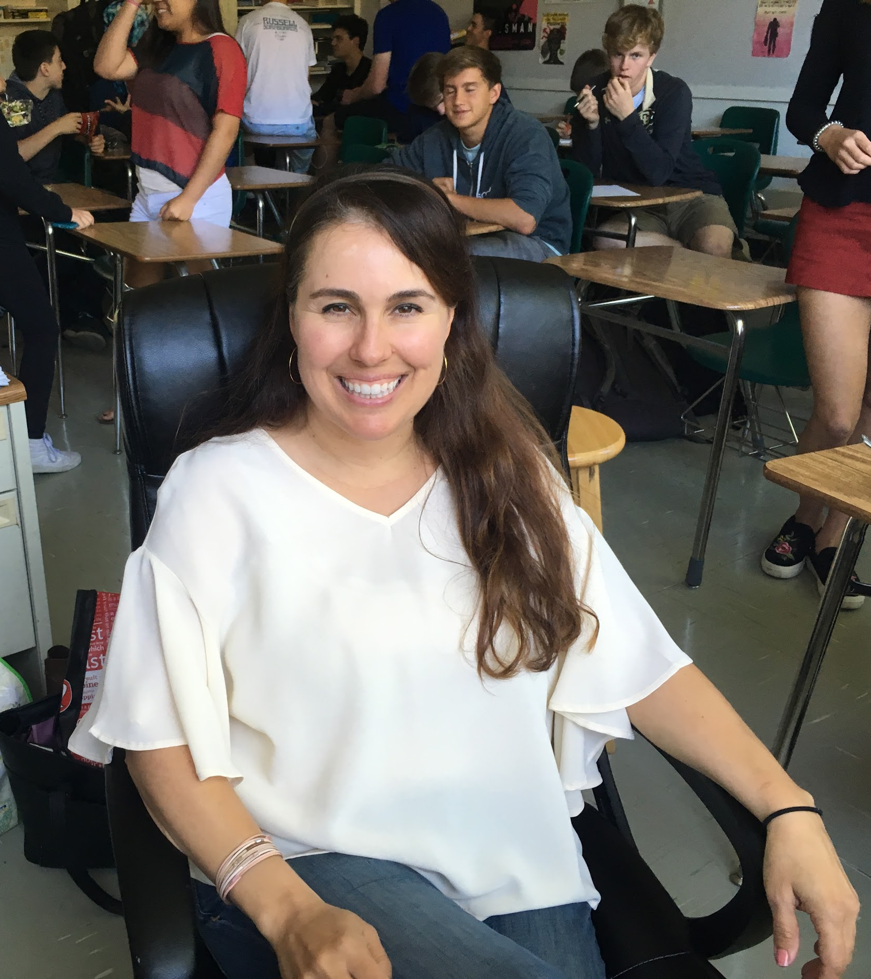
Our shared humanity is what inspires us. We remember connections and authenticity.
“

Slide 22
We met Mrs. Otsuka, an AP Lit and Psych teacher at M-A high school
We were amazed to realize she feels judged by other teachers for using less technology in her lessons (as though she is somehow less advanced).
It would be game changing to validate her style of teaching and reinforce creative lesson planning

Slide 23
How might we...
Empower Mrs. Otsuka, and other teachers like her, to share creative lesson plans?

Slide 24
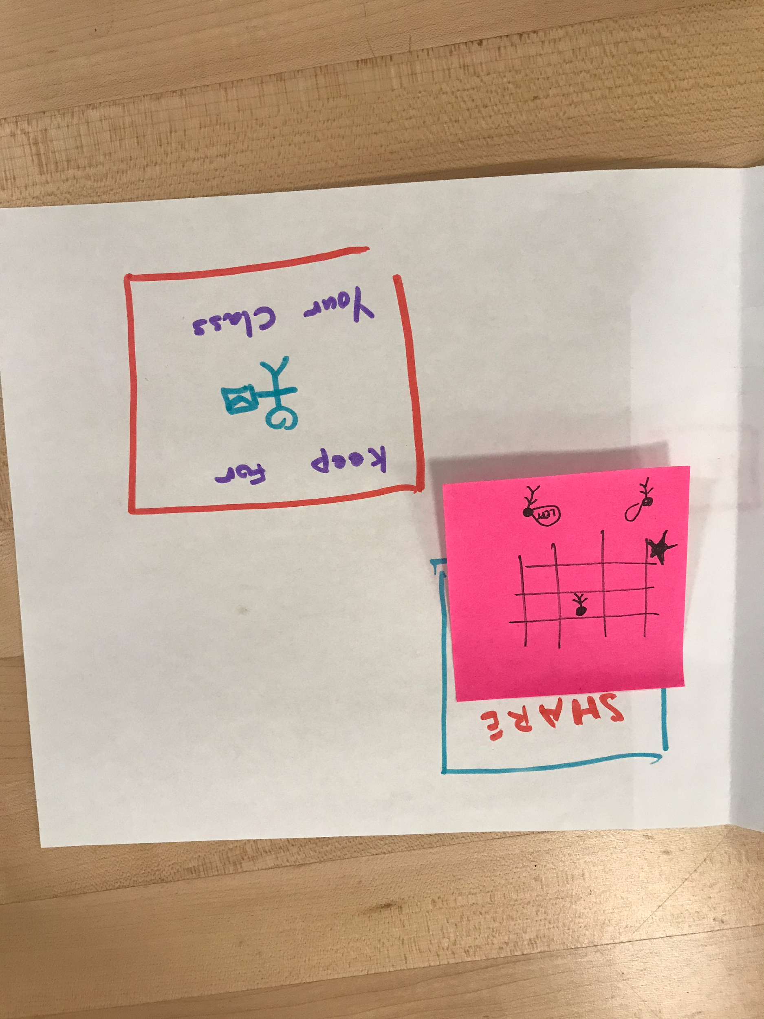
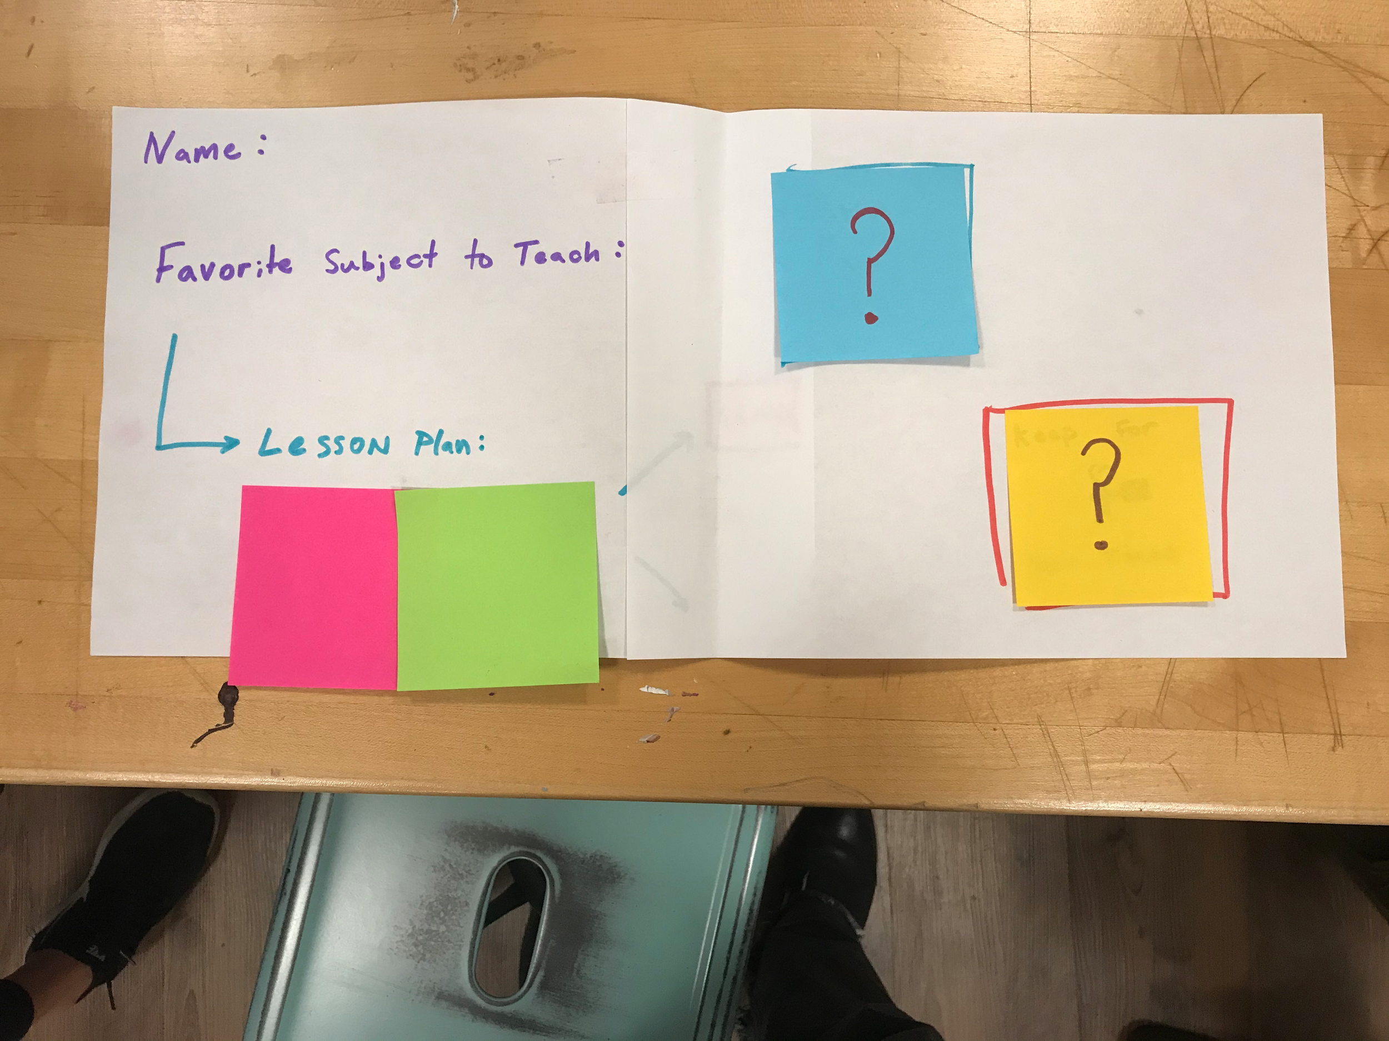
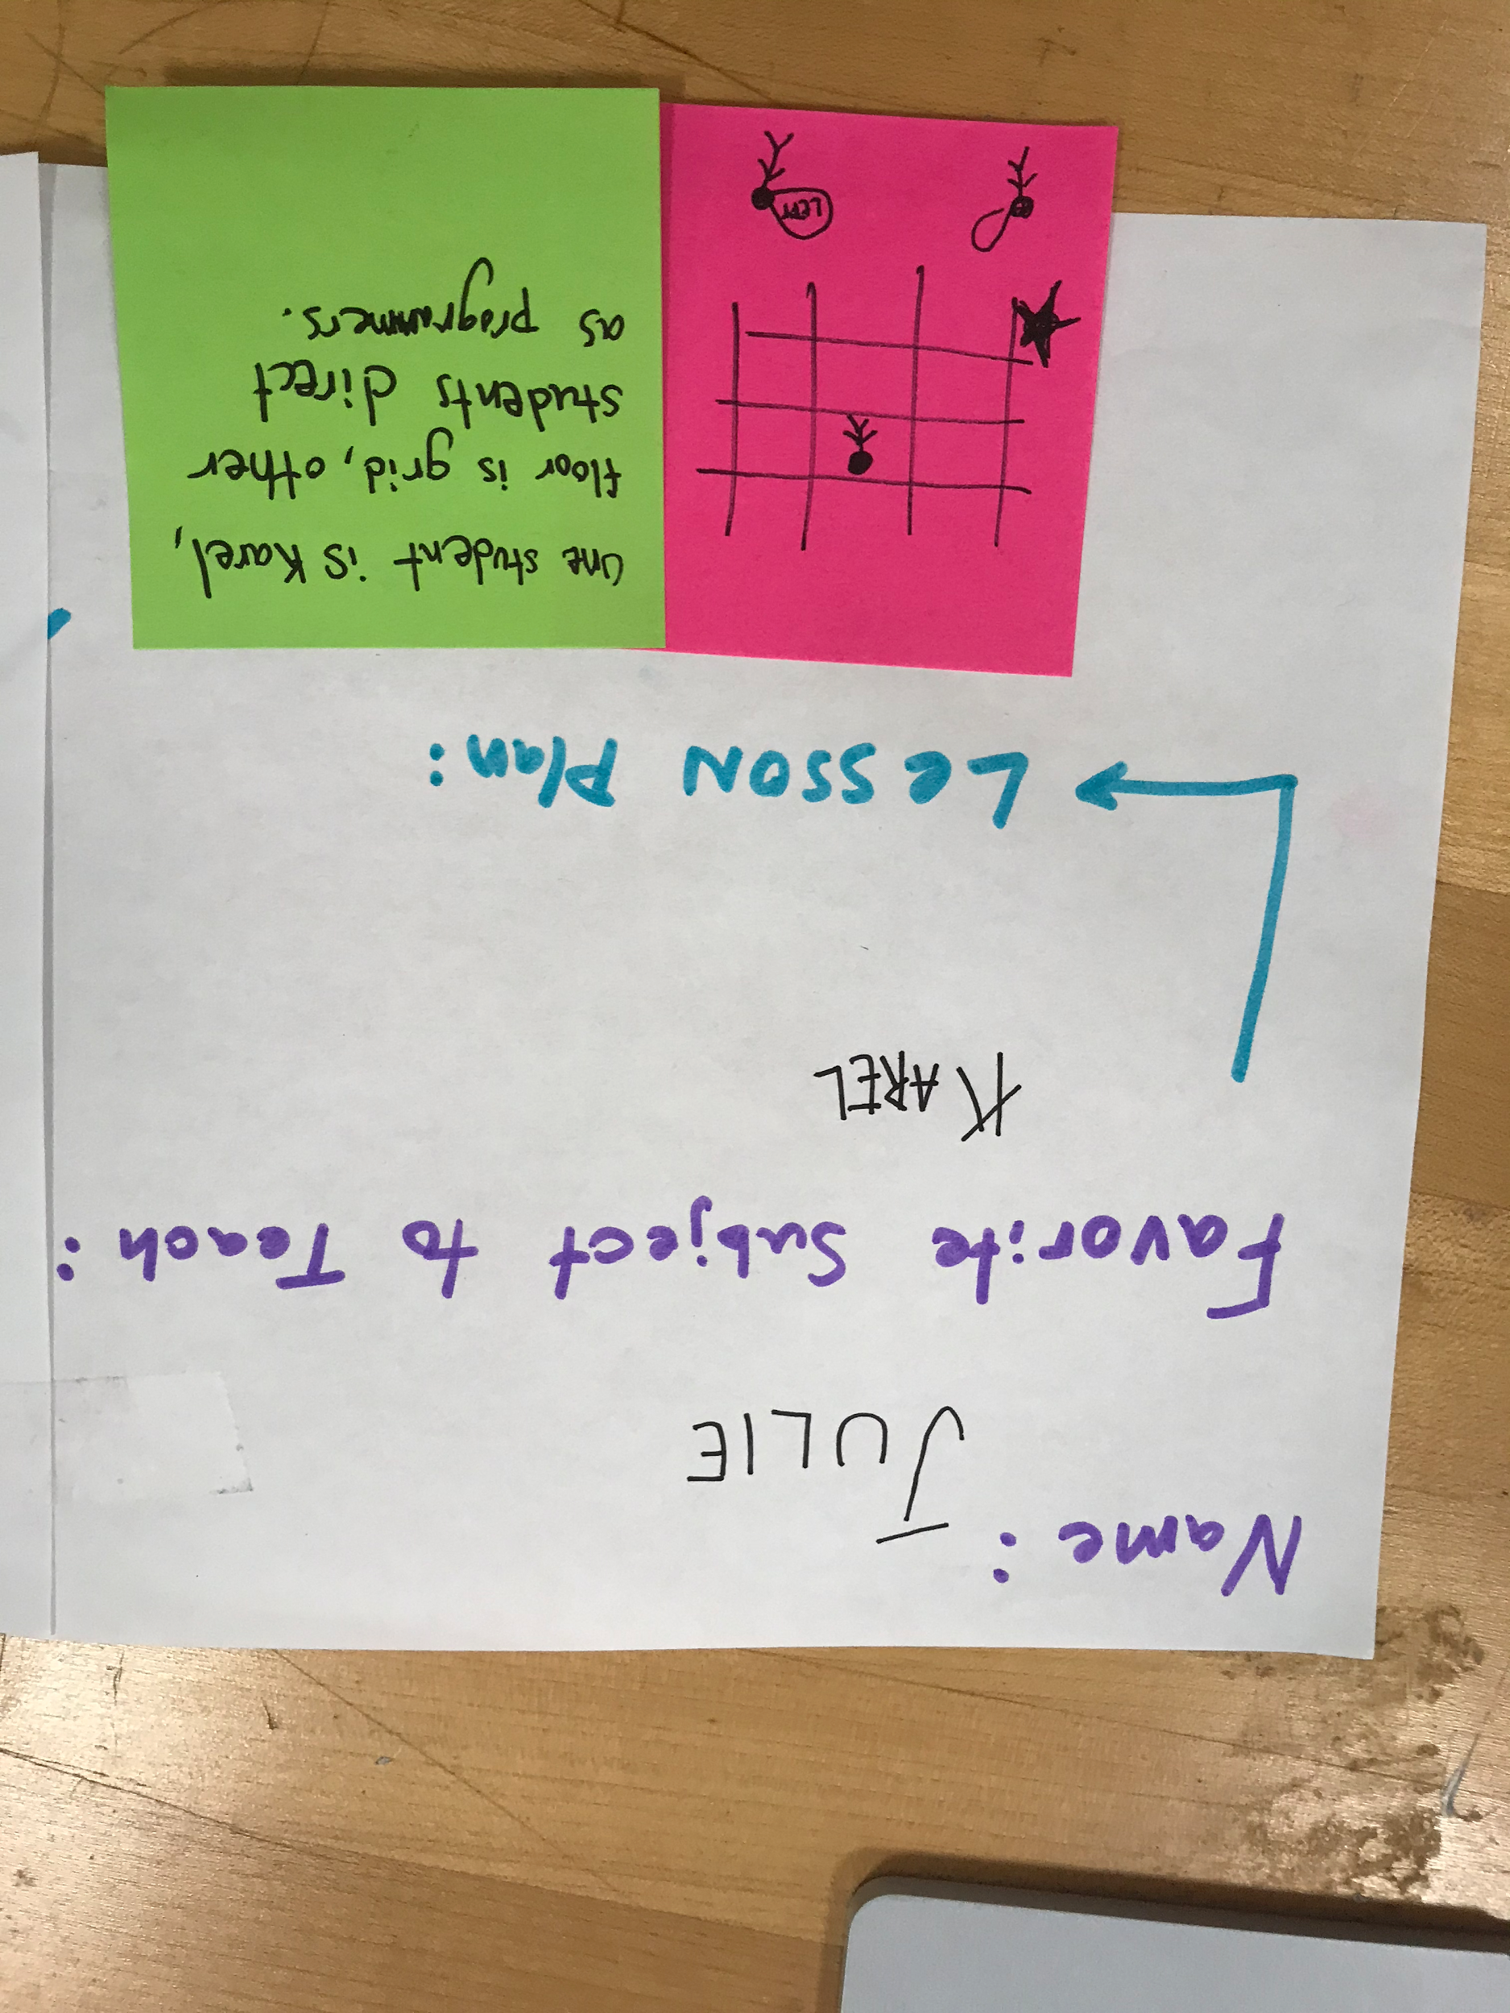
Experience Prototype #2 - Karel For All

Slide 25
Experience Prototype Results
Sense of pride evoked when describing original lesson
Ultimately, willing to share based on reciprocity
Initially hesitant to share cherished lesson plan
Could be annoying to take time to “upload” plan

Slide 26

*Subject did not want picture taken
I believe children should have the ability to choose their path in education
“
Notes:
Paraphrased by eli

Slide 27
We met Cathy, an American Sign Language professor at Stanford
We were amazed to realize that she thinks children should be given more freedom in their ability to choose how they learn
It would be game changing to provide a guideline to empower children and young adults to choose how they want to learn

Slide 28
How might we...
Help students and teachers determine which learning style they’re most receptive to?

Slide 29
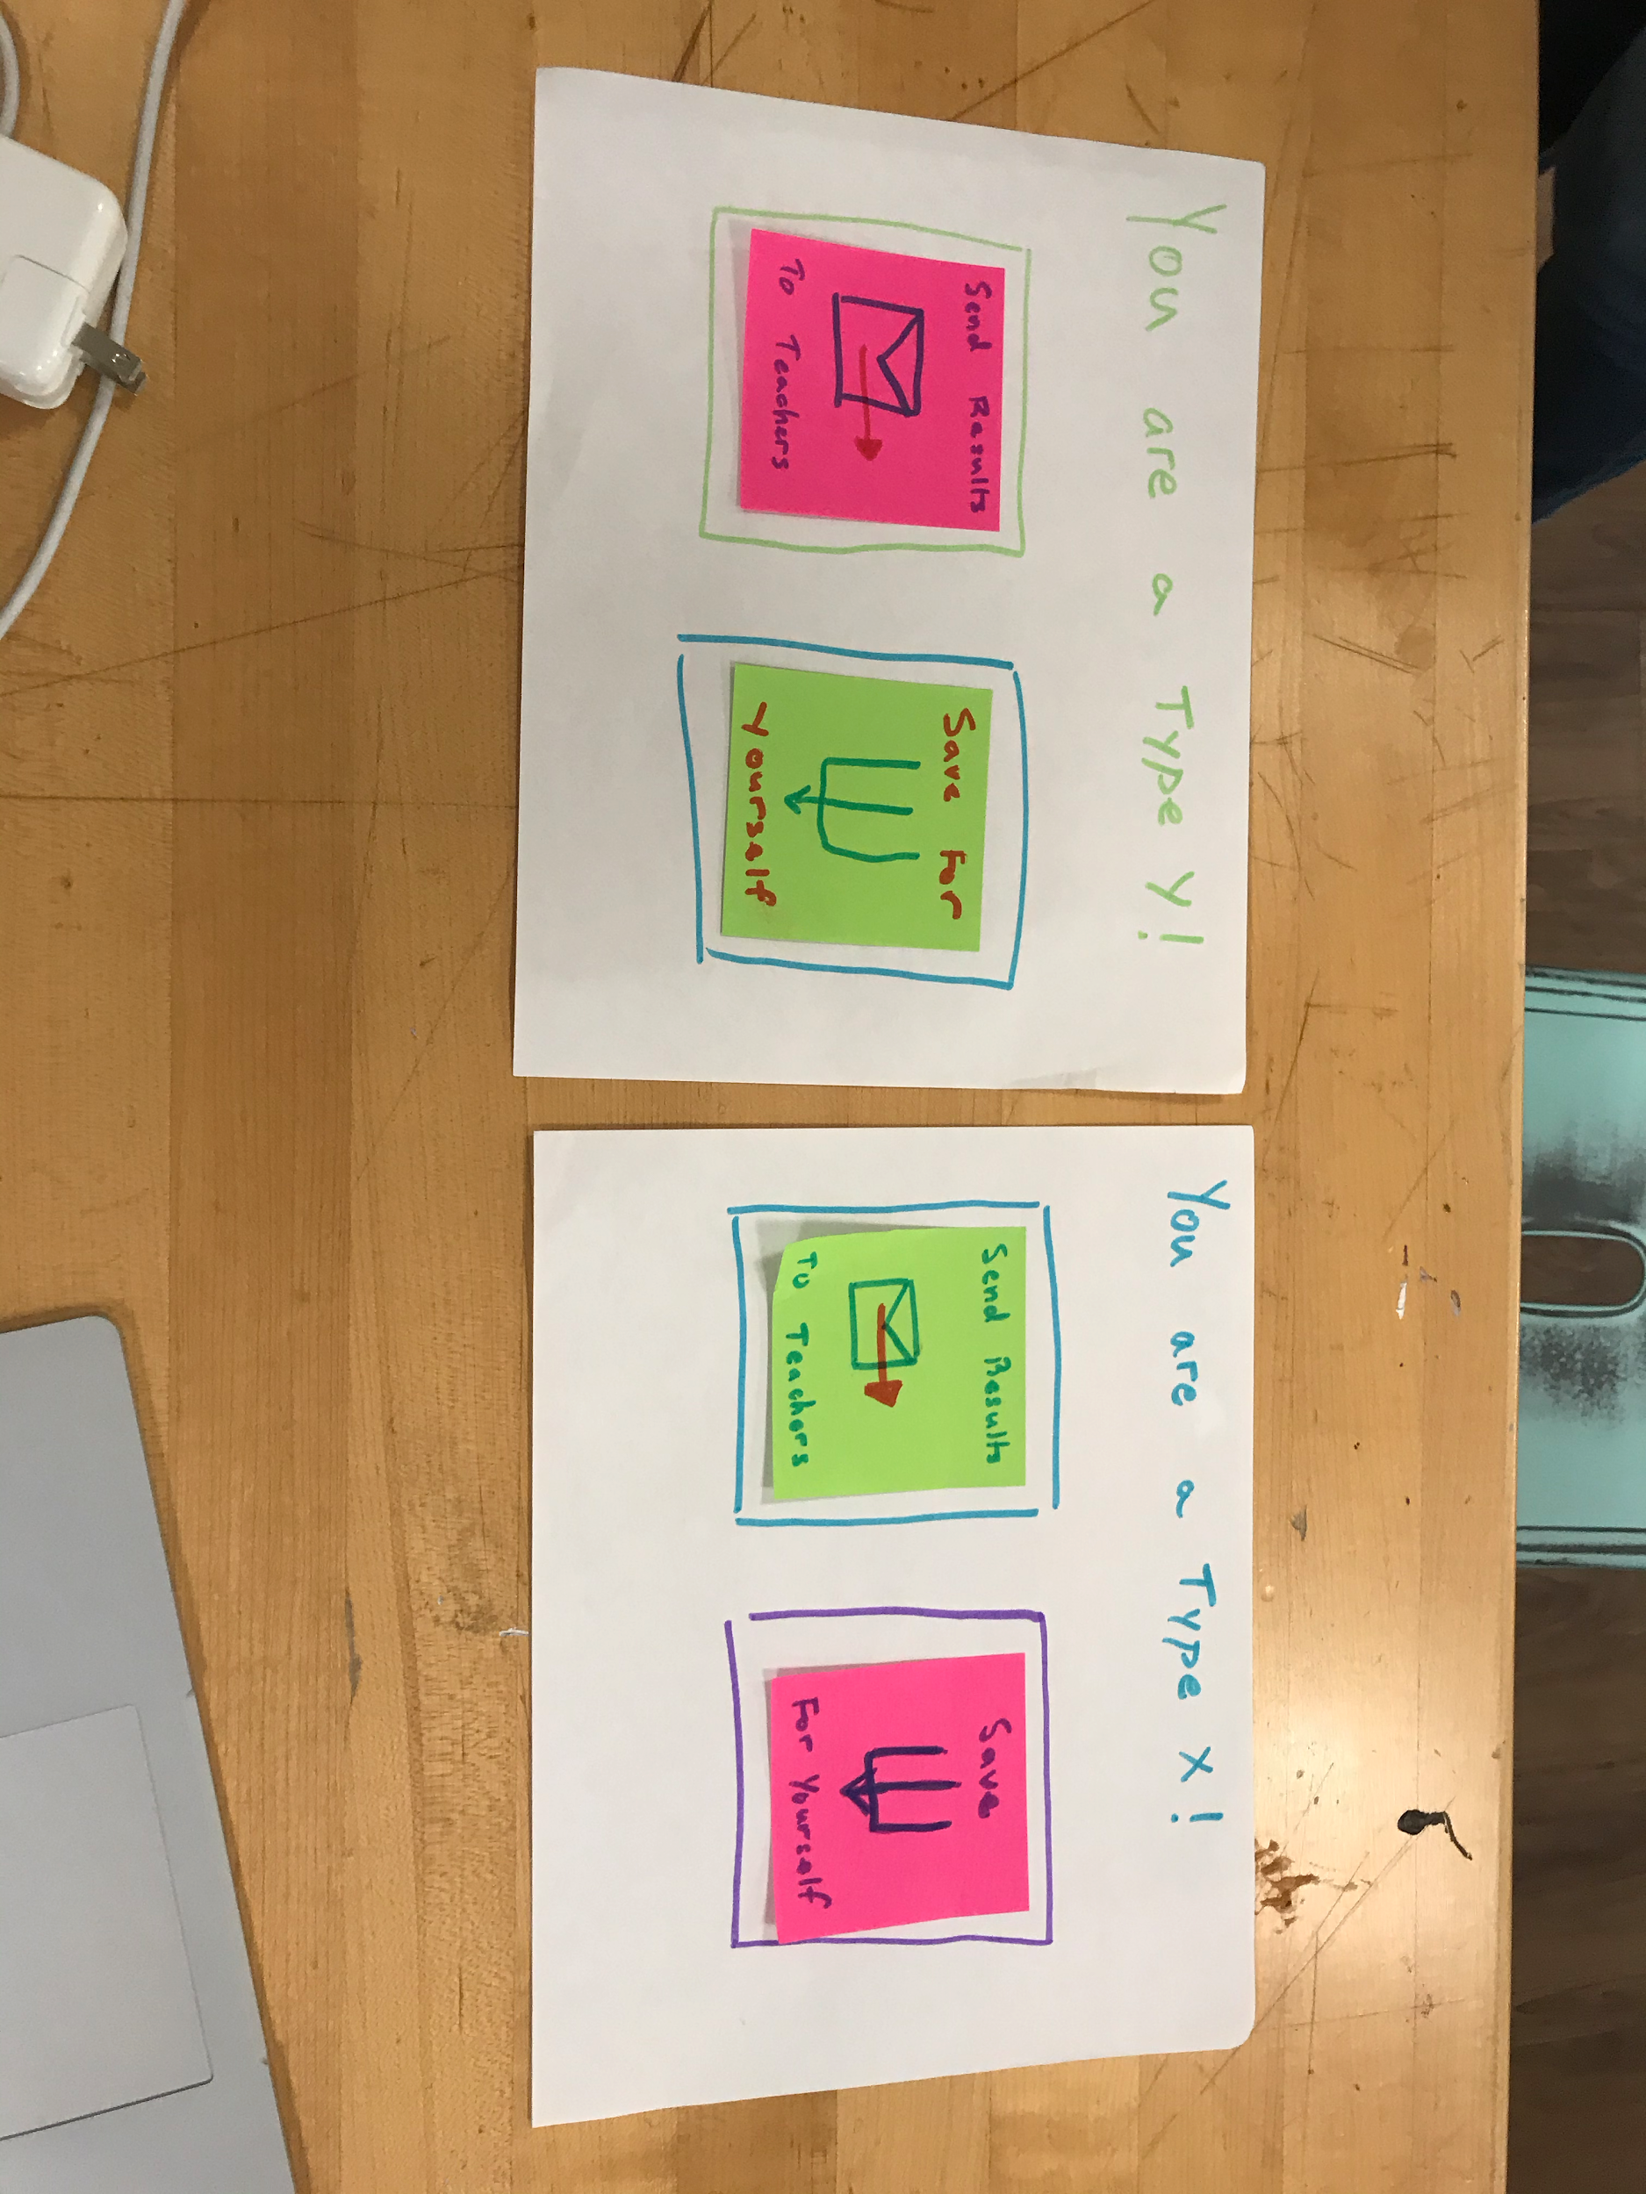
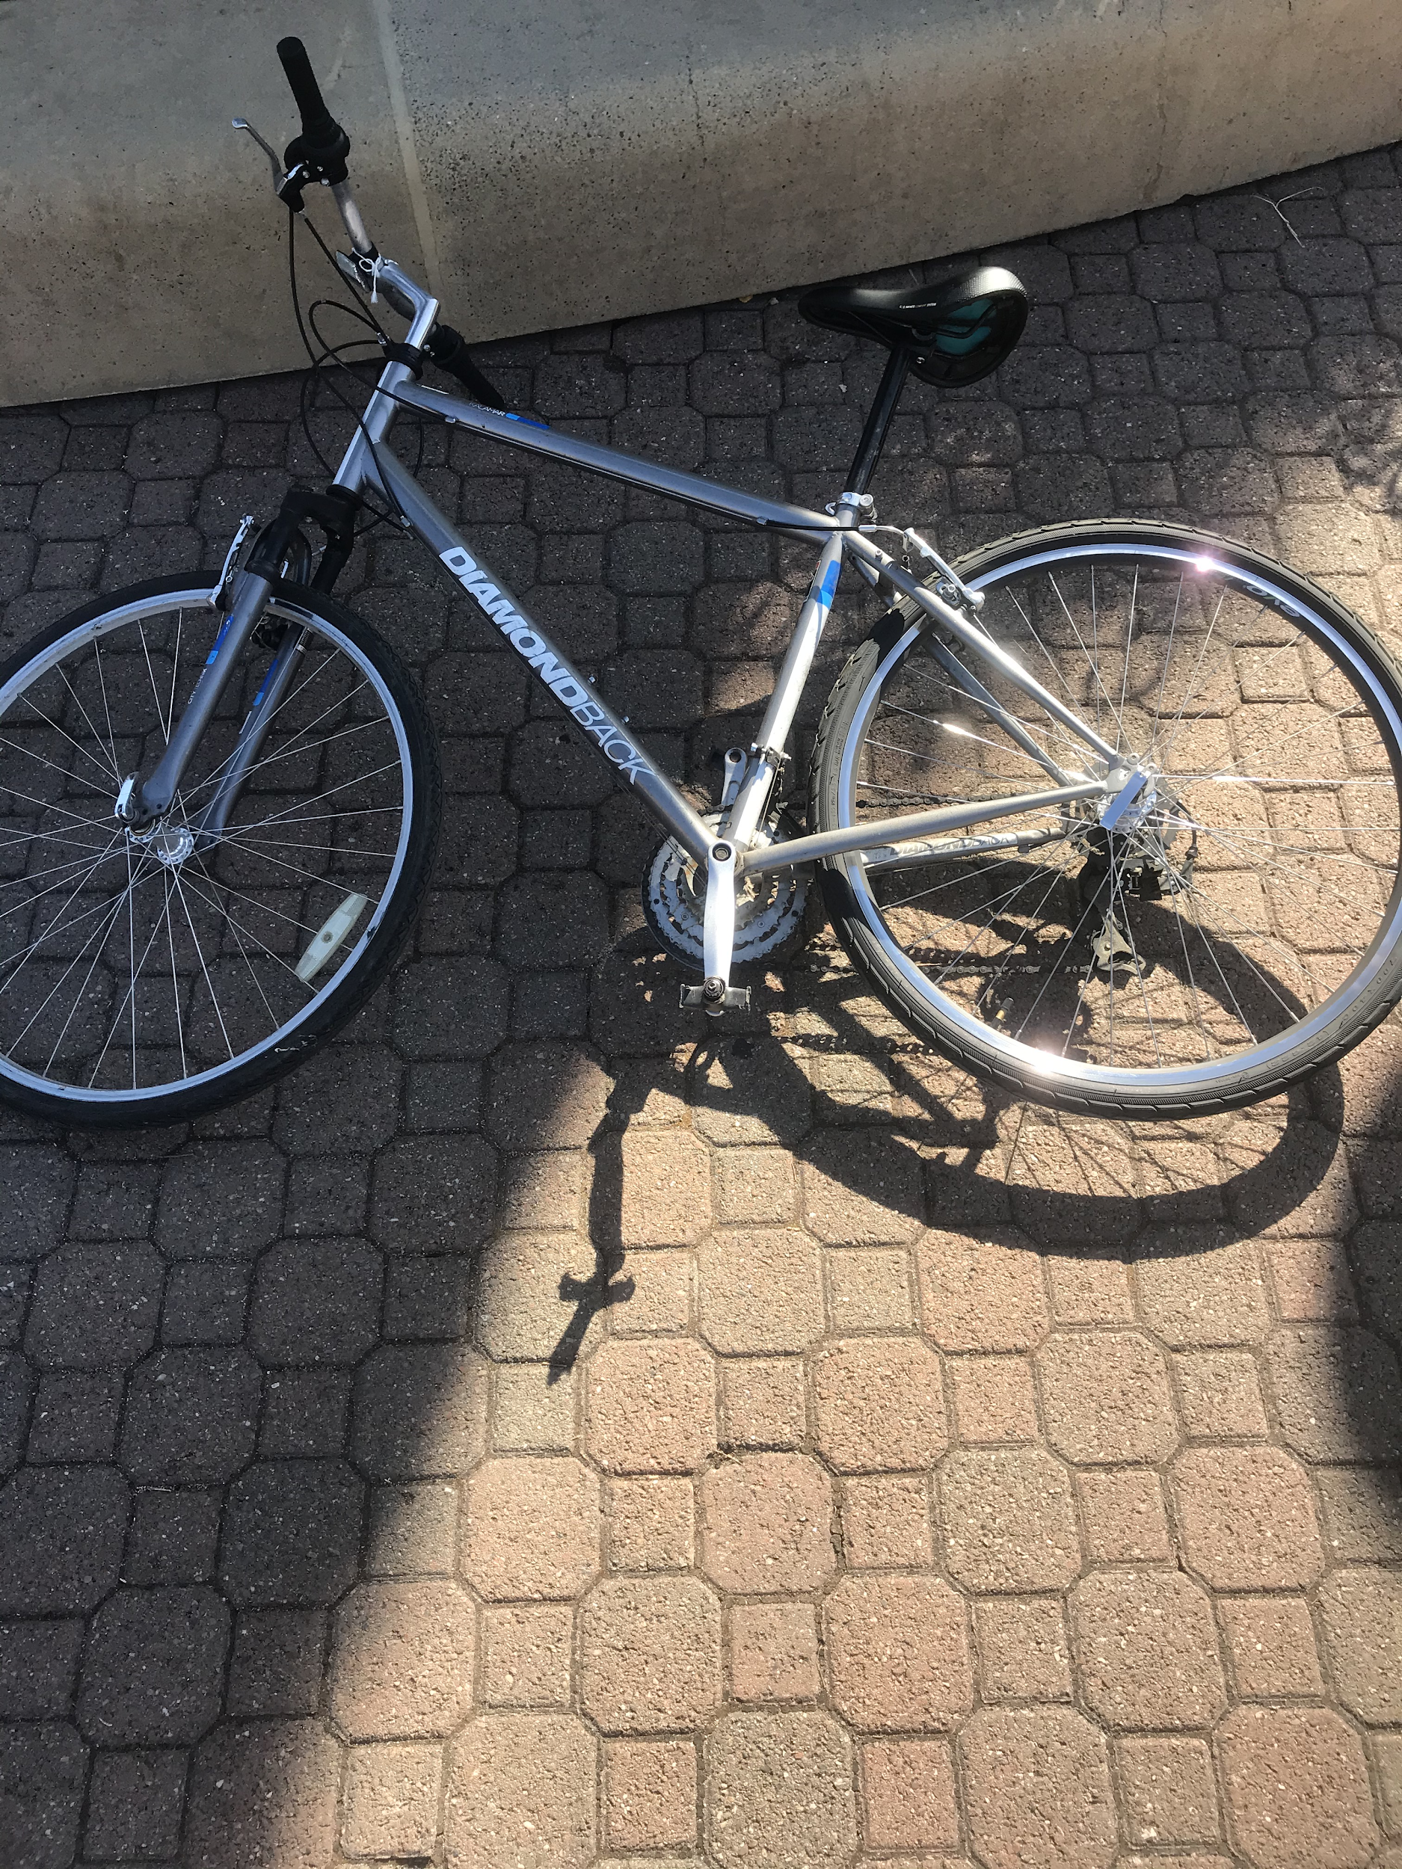
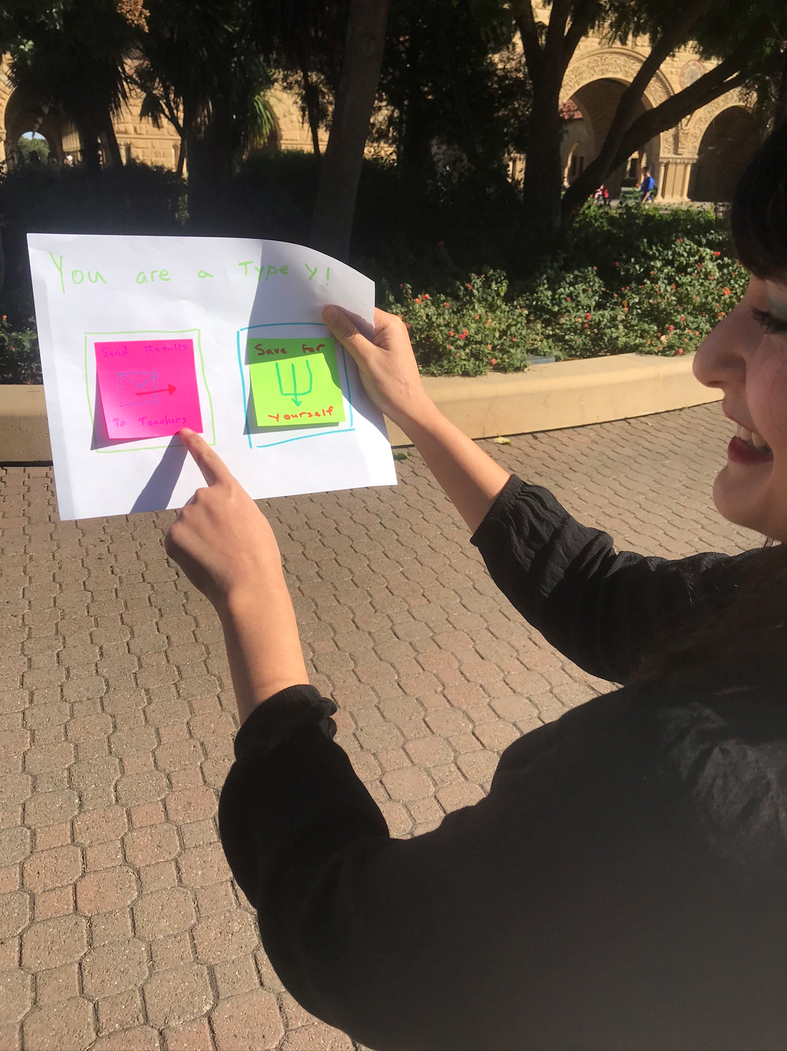
Experience Prototype #3 - Bike Stand Challenge

Slide 30
Experience Prototype Results
Intuitive to share problem solving results
“This might be useful for my teachers”
Can be confusing to be labeled a “type”
Concerns about actionable insights

